Slide 1
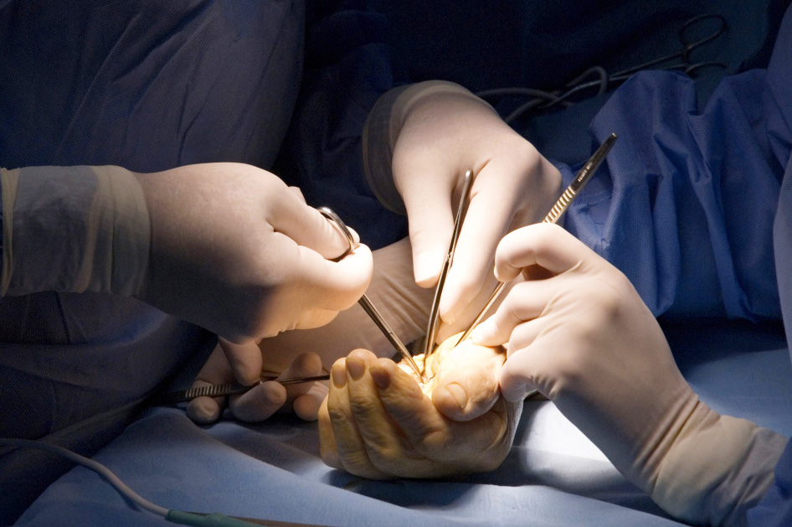
Global Hand Teaching Programme
Module 6.6
Elbow fractures
Case based discussions

Slide 2
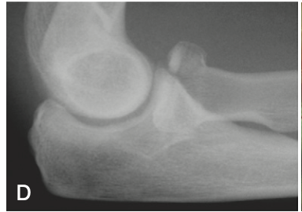
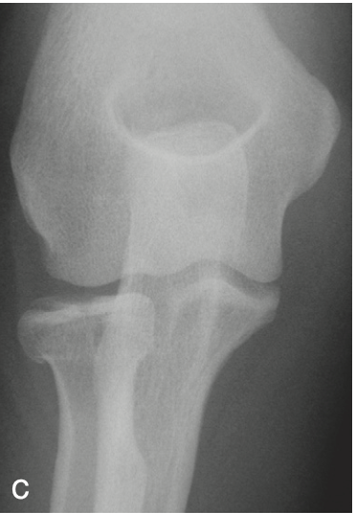
Case 1
A 30 year old man presents with a fall onto an outstretched hand. He presented with swelling to his elbow and bruising along his forearm.
bssh.ac.uk

Slide 3
Case 1
What ligaments can be injured in radial head fractures?
What is the classification system used in radial head fractures?
bssh.ac.uk

Slide 4
Case 1
What ligaments can be injured in radial head fractures?
What is the classification system used in radial head fractures?
bssh.ac.uk

Slide 5
Case 1
When can radial head fractures be managed non-operatively?
What types of surgical treatment options can be used in managing radial head fractures?
bssh.ac.uk

Slide 6
Case 2
A 60 year old lady presents following a fall onto an outstretched hand. She is unable to extend her elbow.
bssh.ac.uk

Slide 7
Case 2
What classification systems are used in olecranon fractures?
Discuss the anatomy of the elbow joint and the structures that insert into this area.
bssh.ac.uk

Slide 8
Case 2
What classification systems are used in olecranon fractures?
Discuss the anatomy of the elbow joint and the structures that insert into this area.
What operative options can be used in olecranon fractures?
bssh.ac.uk

Slide 9
Case 3
A footballer presents with a fall and dislocated his elbow. This is a post-reduction radiograph.
Please discuss the radiograph findings.
bssh.ac.uk

Slide 10
Case 3
What is the biomechanics of the coronoid in terms of elbow function?
What are the classification systems used in coronoid fractures?
What are the treatment options used in these fractures?
bssh.ac.uk

Slide 11
Case 3
What is the terrible triad of elbow?
Why are these injuries difficult to treat? What complications could ensue following these injuries?
bssh.ac.uk

Slide 12
Questions?

Slide 13
Teaching feedback link M6.6
https://s.surveyplanet.com/fjo1nxgq

