Slide 1
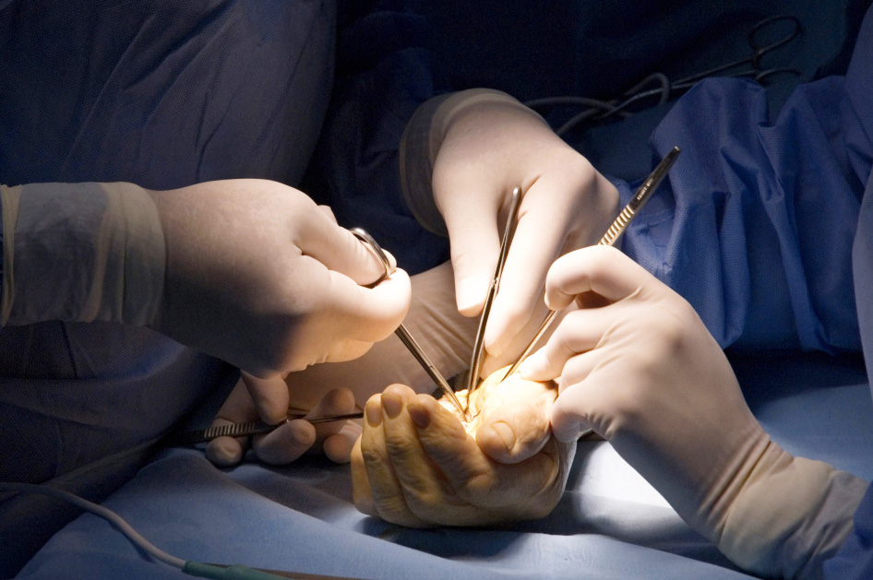
Global Hand Teaching Programme
Module 6.5
Forearm fractures
Case based discussions

Slide 2
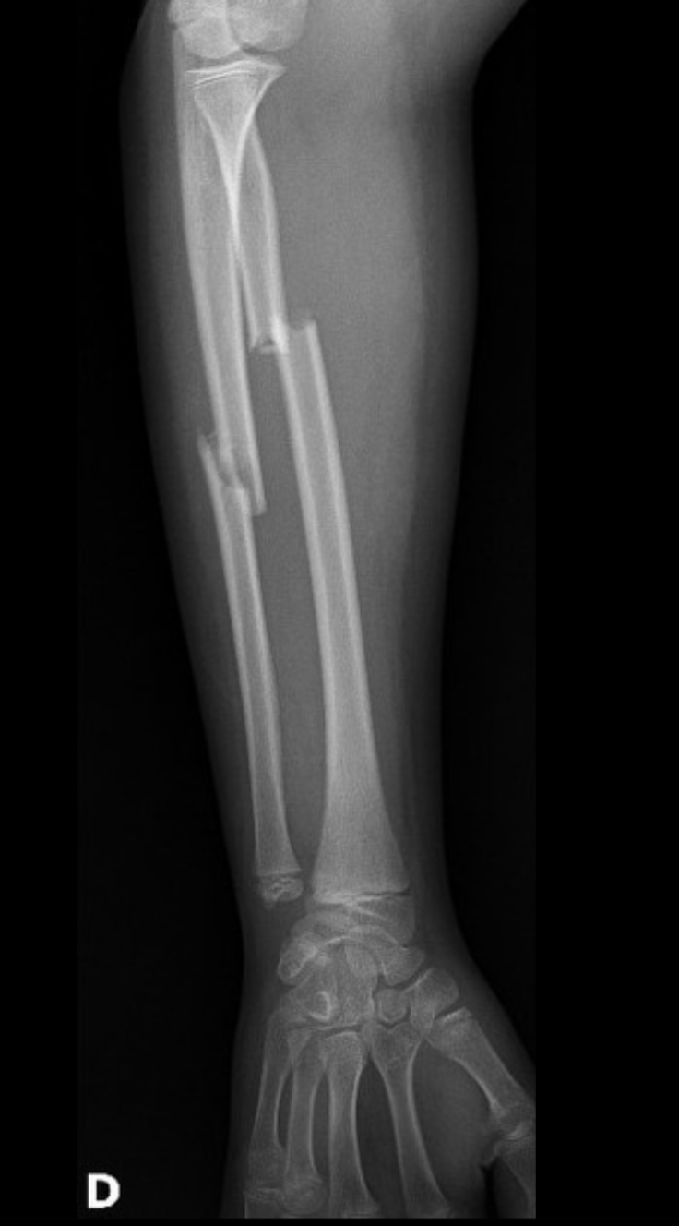
Case 1
A 30 year old construction worker presents with a painful forearm having fallen from a 2-storey building. He sustained a closed injury to his right forearm.
Describe the radiograph
bssh.ac.uk

Slide 3
Case 1
What range of motion does the forearm perform, and which joints are involved in the motion?
What structures are at risk of injury here?
bssh.ac.uk

Slide 4
Case 1
What is your preferred method of fixation in this particular case? What would your surgical approach be?
bssh.ac.uk

Slide 5
Case 1
What complications can arise if forearm fractures are not managed adequately?
bssh.ac.uk

Slide 6
Case 2
This 20 year old man presents with a painful forearm following being hit by a baseball bat when he was in a fight.
What is the injury sustained here?
bssh.ac.uk

Slide 7
Case 2
When would you consider non-operative treatment to isolated ulnar fractures?
For open reduction internal fixation of this injury, what would your approach be? What key structures would you need to identify and protect?
bssh.ac.uk

Slide 8
Case 2
How does intramedullary rods work? Would they be appropriate in this injury?
bssh.ac.uk

Slide 9
Case 3
This 30 year old man presents with discomfort and limitation to his right forearm movement. He reports that approximately ten years ago he had broken his forearm and this was managed in a cast.
What does the radiograph demonstrate?
bssh.ac.uk

Slide 10
Case 3
What are the common issues faced by patients with non-union or malunion of the radius and ulna?
What would you pre-operative evaulation involve?
What treatment options are available for patients with non-union or malunion of the radius and ulna?
bssh.ac.uk

Slide 11
Questions?

Slide 12
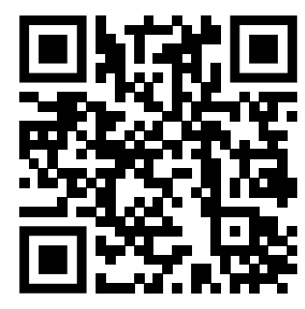
Teaching feedback link M6.5
https://s.surveyplanet.com/ywb3ne6m

