Slide 1
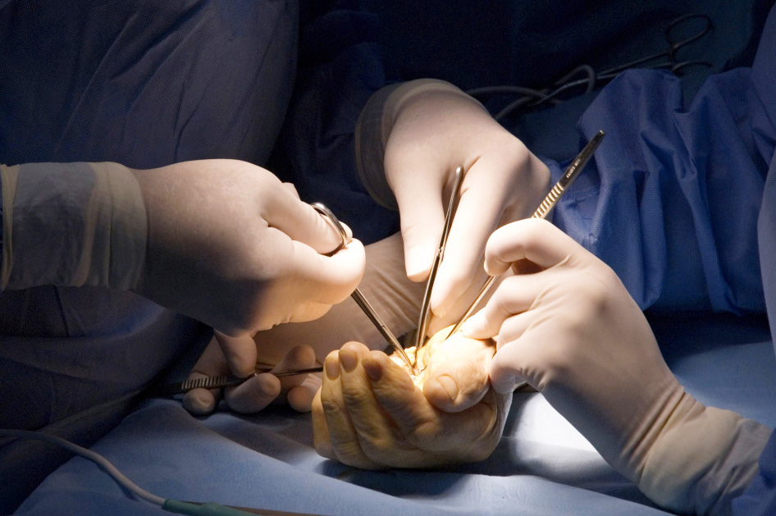
Global Hand Teaching Programme
Module 5.12:
Other systemic inflammatory disorders (SLE, systemic sclerosis, Raynauds, psoriasis)
Case based discussions

Slide 2
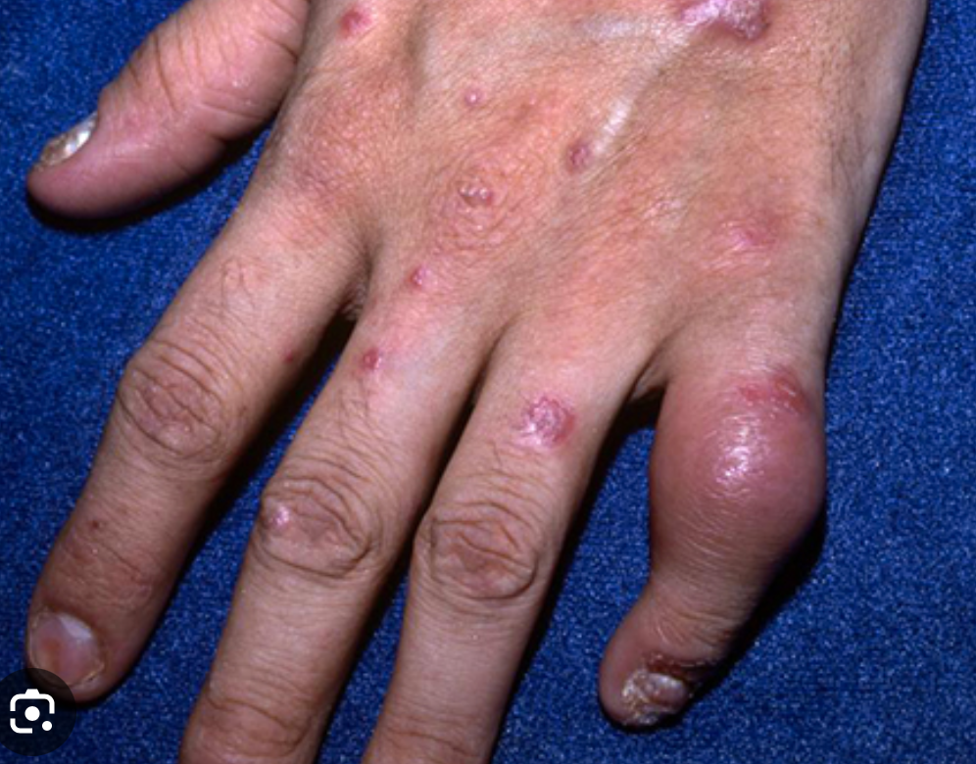
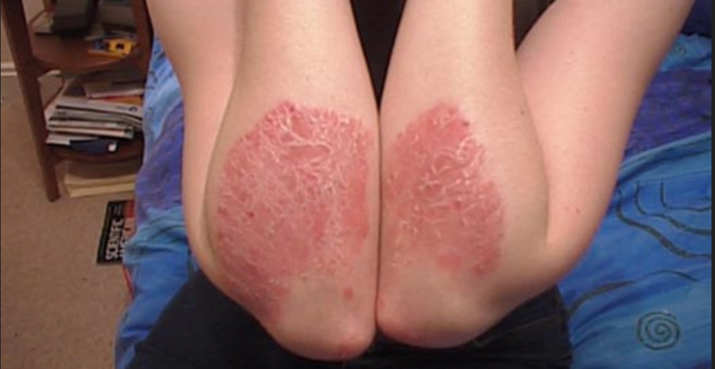
Case 1
A 50 year old man presents to your clinic with a painful left little finger. You also notice a scaly rash over the dorsum of both hands and over the elbows.
bssh.ac.uk

Slide 3
Case 1
What is psoriatic arthritis?
What are the common features seen in psoriatic arthritis?
What is the genetic association seen in this condition?
bssh.ac.uk

Slide 4
Case 1
What is psoriatic arthritis?
What are the common features found on physical examination in psoriatic arthritis?
What is the genetic association seen in this condition?
bssh.ac.uk

Slide 5
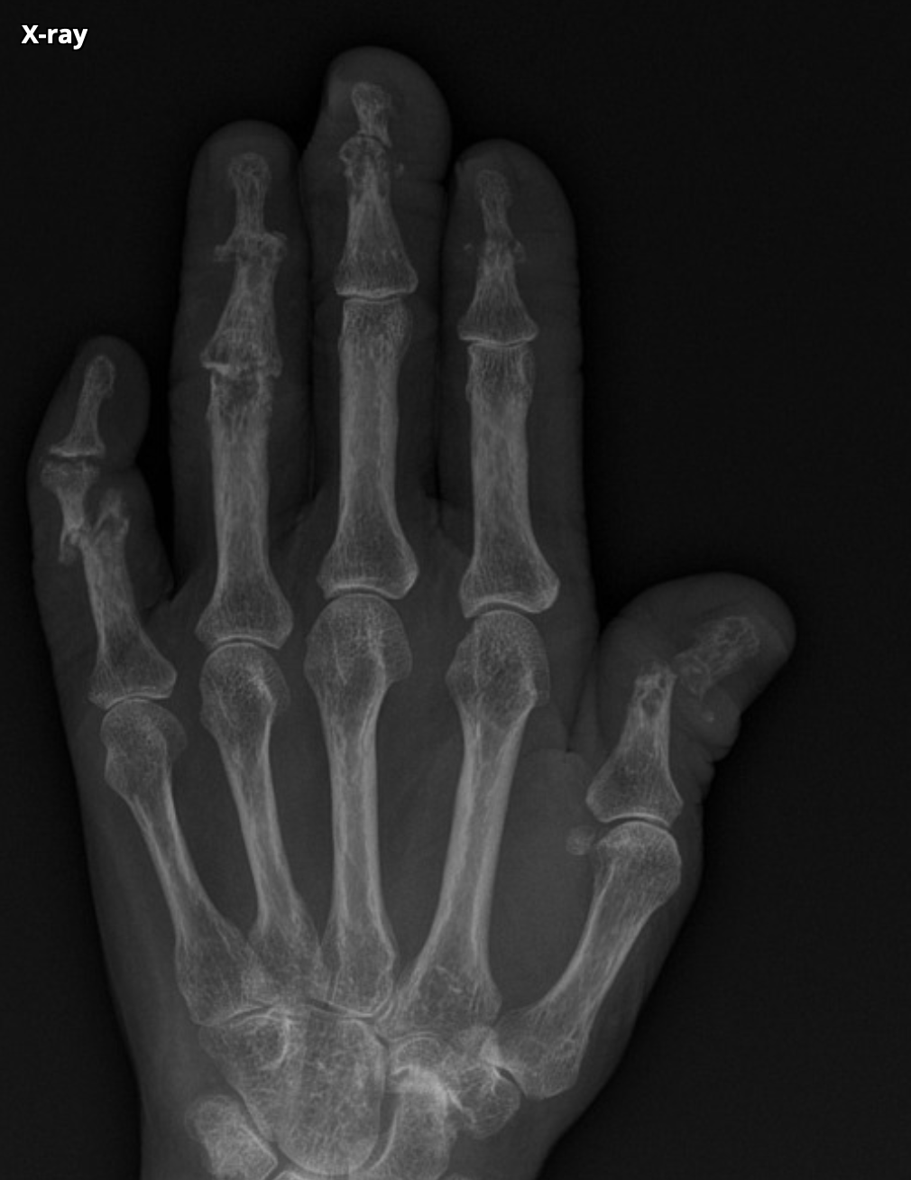
Case 1
What is the common X-ray finding seen in psoriatic arthritis?
What are the non-operative and operative treatment options for this condition?
bssh.ac.uk

Slide 6
Case 1
What is psoriatic arthritis?
What are the common features found on physical examination in psoriatic arthritis?
What is the genetic association seen in this condition?
bssh.ac.uk

Slide 7
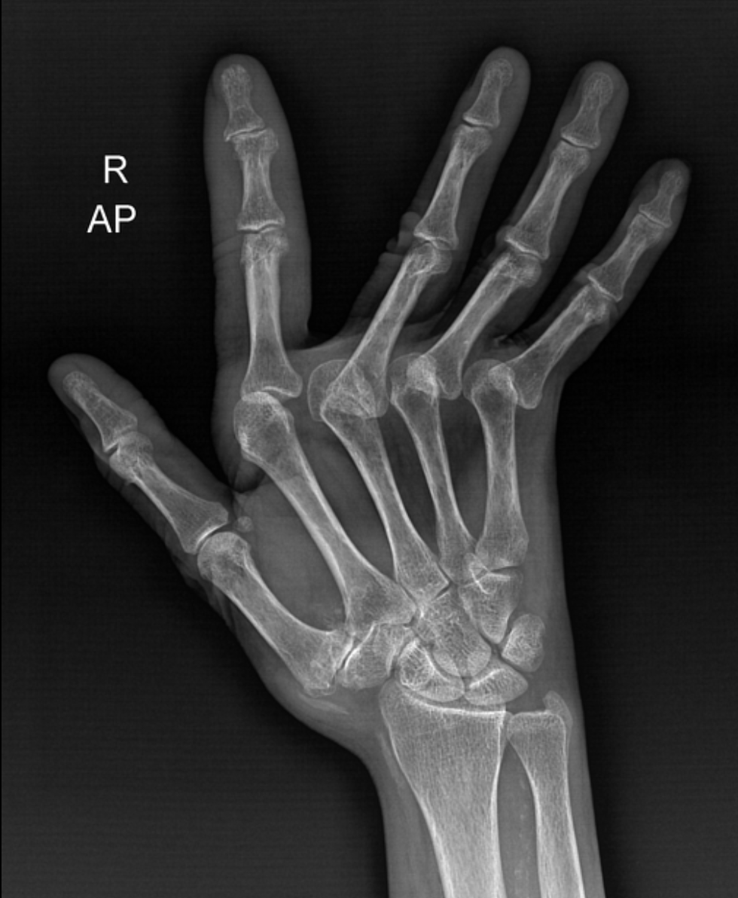
Case 2
A 16 year old girl presents to you with nonspecific joint pain affecting all small joints of the hand. You also notice that she has a rash over both cheeks and that she has recently had a consult with the cardiologist for pericarditis.
bssh.ac.uk

Slide 8
Case 2
What is systemic lupus erythematosus? How does it differ from rheumatoid arthritis?
What major organs can SLE affect?
What demographic does SLE typically affect?
bssh.ac.uk

Slide 9
Case 2
How is SLE diagnosed?
What are the medical treatment options for SLE?
bssh.ac.uk

Slide 10
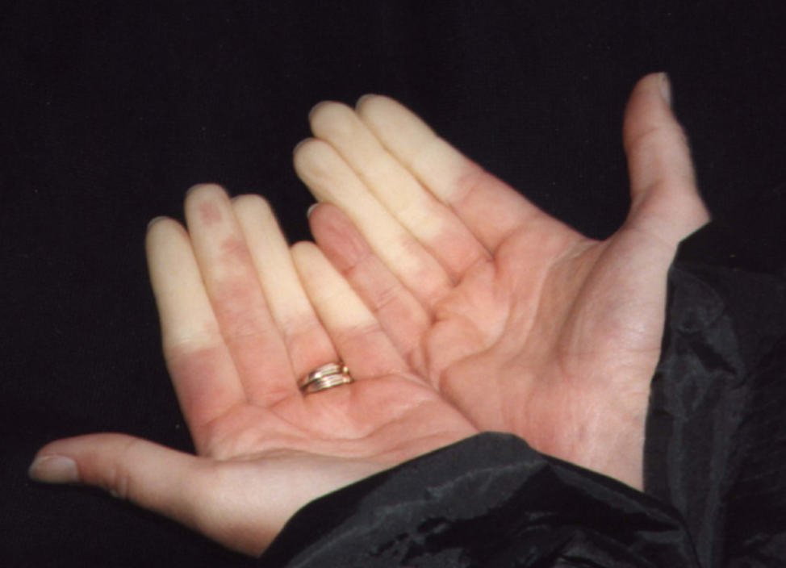
Case 3
A 31 year old woman presents to your clinic complaining of painful and cold fingers affecting both hands especially when she is outdoors.
bssh.ac.uk

Slide 11
Case 3
What is Raynaud’s?
What is the demographic that is most commonly affected by Raynaud’s
What are the conditions that Raynaud’s is associated with?
bssh.ac.uk

Slide 12
Case 3
What medical management options and lifestyle modifications can be offered?
What medical treatment in the form of injections can be used in cases where medical management has failed?
What operative options are there?
bssh.ac.uk

Slide 13
Questions?

Slide 14
