Slide 1
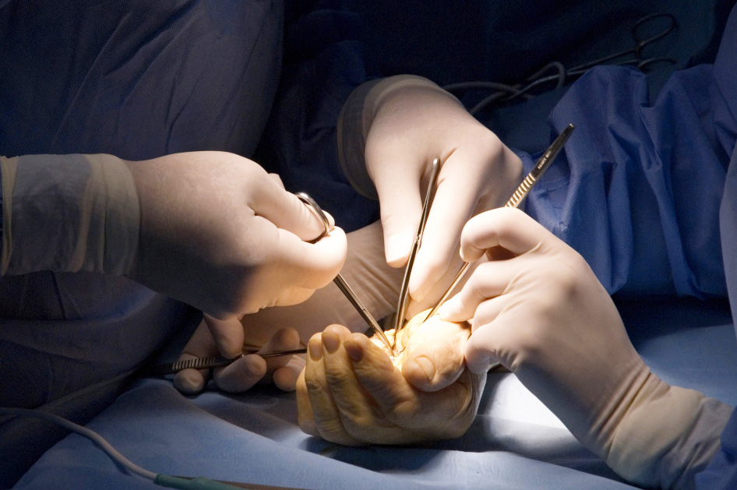
Global Hand Teaching Programme
Module 5.10
Finger arthritis
Case based discussions

Slide 2
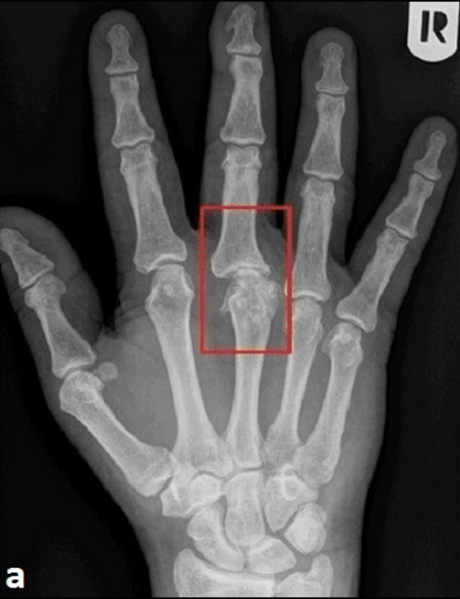
Case 1
A 45 year old man presents with a painful MCPJ to his right middle finger. This joint was previously injured during a fight 10 years ago which developed an infection requiring multiple washouts in theatre.
bssh.ac.uk

Slide 3
Case 1
What are the radiographic findings for osteoarthritis?
Describe the anatomy of the MCPJ and what movements it allows?
What are you looking for on physical examination?
What non-operative treatment options are available?
bssh.ac.uk

Slide 4
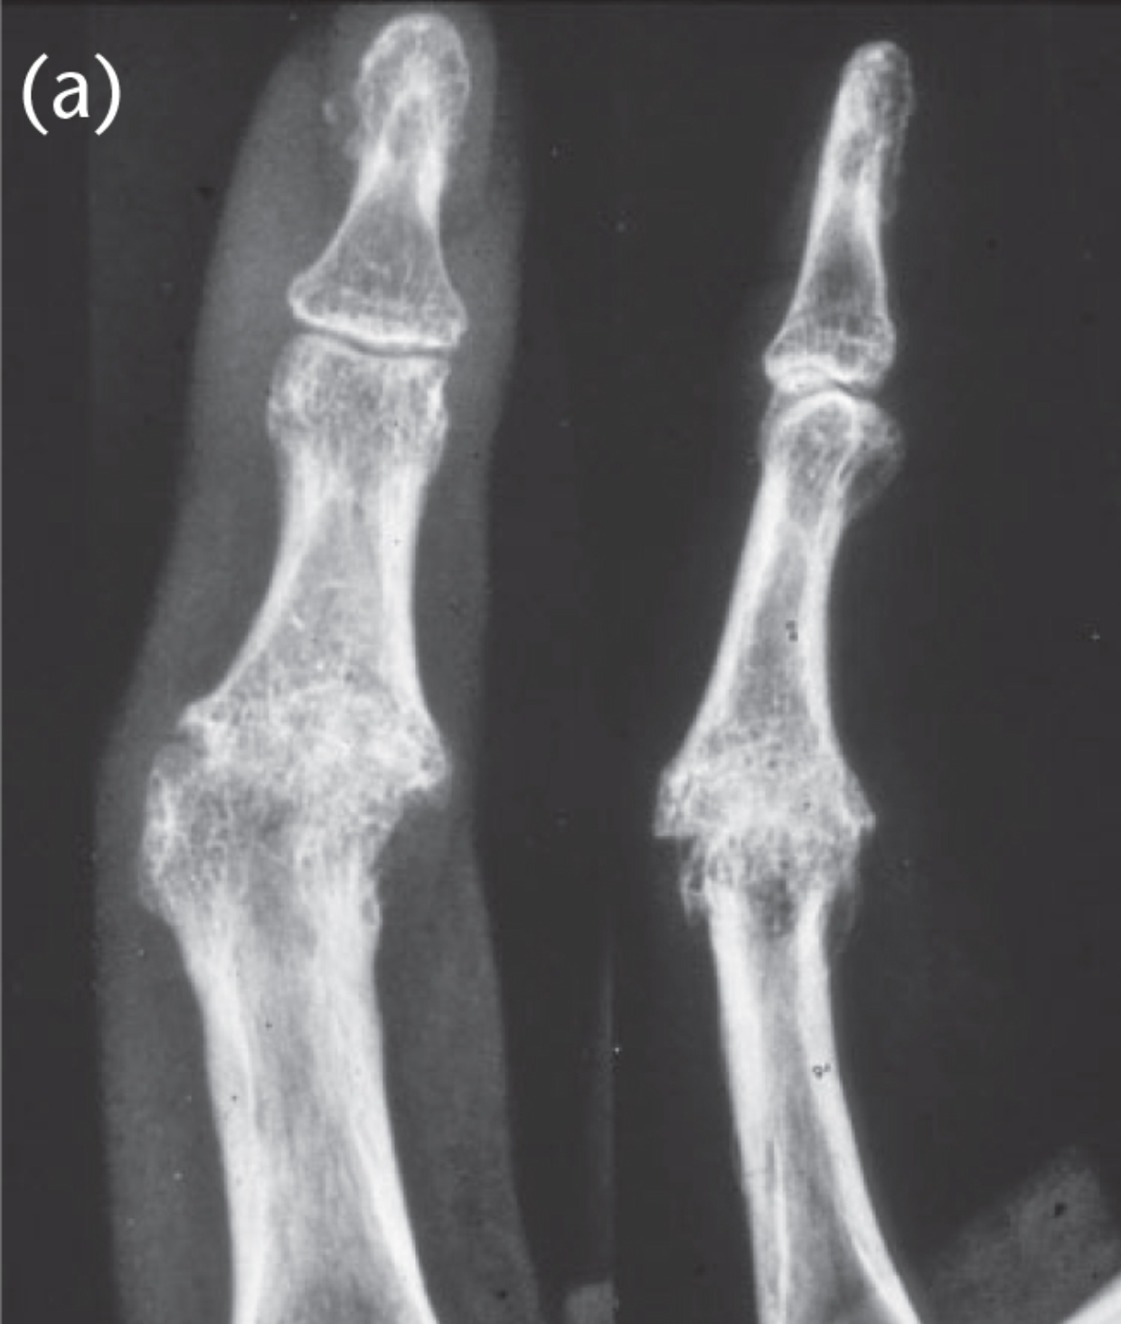
Case 2
A 35 year old retired professional rugby player presents to your clinic complaining of a painful PIPJ to his right index finger. He recalls multiple trauma to this digit including multiple dislocations in the past. His radiograph is shown here.
bssh.ac.uk

Slide 5
Case 2
Describe the anatomy of the PIPJ
What non-operative treatment options can be offered?
What operative treatment options can be offered?
What implants are commonly used for arthroplasty?
How would you select your patient for arthroplasty?
bssh.ac.uk

Slide 6
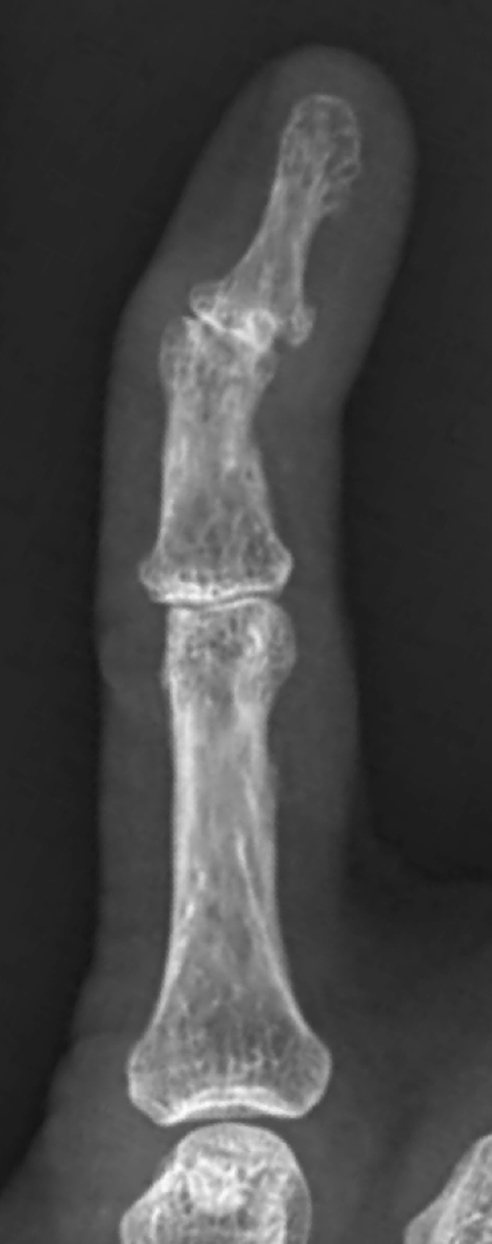
Case 3
A 68 year old woman presents to your clinic complaining of a painful index finger. She works as a typist and is debilitated by the constant pain and would like to discuss treatment options.
Her radiograph of the index finger is shown here.
bssh.ac.uk

Slide 7
Case 3
What is her diagnosis?
What treatment options could be offered in this case?
What would the most functional position of DIPJ be?
bssh.ac.uk

Slide 8
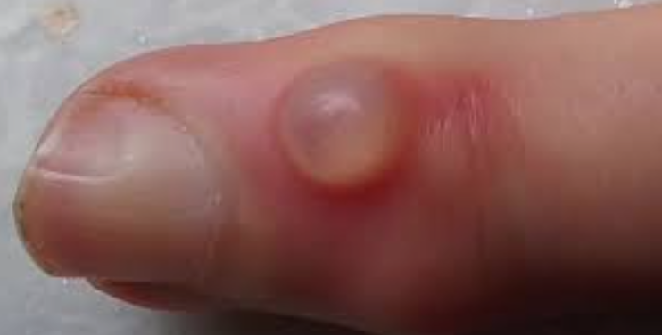
Case 3
The same patient brings your attention to her middle finger. She has noticed this ’cyst-like’ appearance to her middle finger over the past six months. It has occasionally burst and discharged gel-like substance.
What is the diagnosis?
What are the key points to highlight in the discussion with the patient?
bssh.ac.uk

Slide 9
Questions?

Slide 10
