Slide 1
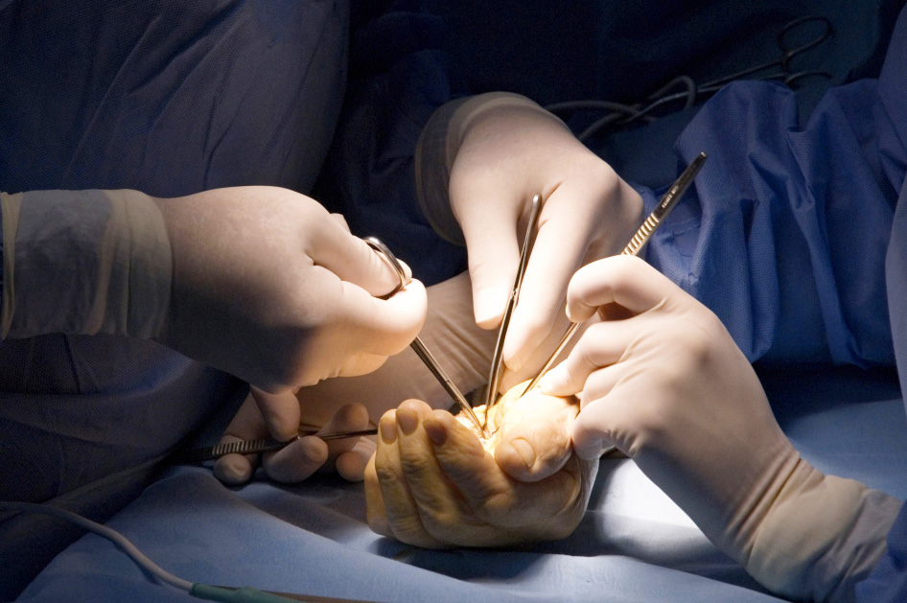
Global Hand Teaching Programme
Thumb arthritis including CMCJ

Slide 2
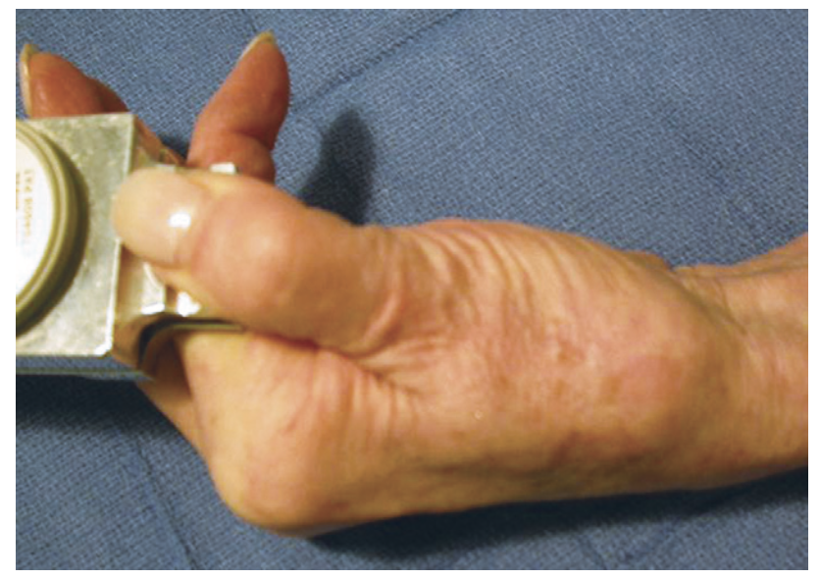
Case 1
65 year old man presents with pain in his left thumb. His thumb aches at the end of the day and he has found his thumb is becoming weaker to grip objects. He is also finding writing a challenge.
What are the classical clinical signs of osteoarthritis of the thumb?
Can you explain the reasons anatomically and pathologically for the appearance of the thumb?
How will the examination of the arthritic thumb change with severity?
What is meant by a ‘positive grind test’?
Green’s Operative Hand Surgery
bssh.ac.uk

Slide 3
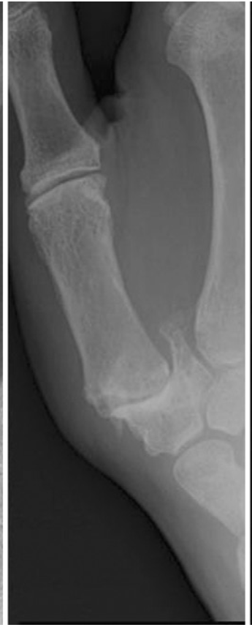
Case 2
The previous patient re-attends clinic 12 months after the first visit. His XR’s are as shown. His symptoms are worsening.
Can you describe the XR features?
Do you know any classifications used for thumb arthritis?
What is a basal joint stress and why would it be useful to obtain this?
Since the patient has not responded to analgesia, steroid injections and splinting, what treatment options would you offer?
Green’s operative textbook
bssh.ac.uk

Slide 4
For further information please
get in touch via the channels below:

