Slide 1
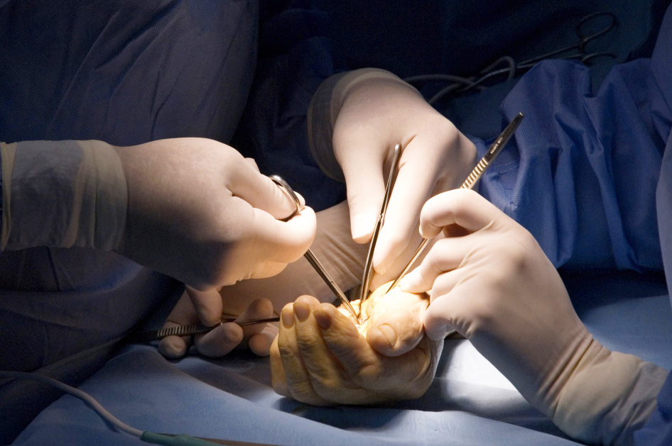
Global Hand Teaching Programme
Module 4.8
MDT Management of tumours

Slide 2
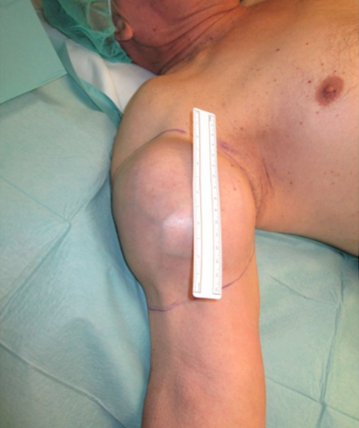
Case 1
A 56 year old man presents with a rapidly enlarging lump to his right upper arm. He has no relevant past medical history. The lesion is associated with severe pain, not relieved by simple analgesias.
What classification system is used to stage malignant tumours?
bssh.ac.uk

Slide 3
Case 1
A 56 year old man presents with a rapidly enlarging lump to his right upper arm. He has no relevant past medical history. The lesion is associated with severe pain, not relieved by simple analgesias.
What imaging modalities can help with the diagnosis and staging of malignant tumours?
bssh.ac.uk

Slide 4
Case 1
A 56 year old man presents with a rapidly enlarging lump to his right upper arm. He has no relevant past medical history. The lesion is associated with severe pain, not relieved by simple analgesias.
In order to obtain a tissue diagnosis, what kinds of biopsy can be performed?
bssh.ac.uk

Slide 5
Case 1
A 56 year old man presents with a rapidly enlarging lump to his right upper arm. He has no relevant past medical history. The lesion is associated with severe pain, not relieved by simple analgesias.
In a sarcoma multi-disciplinary team, who are the team members and what is their role?
bssh.ac.uk

Slide 6
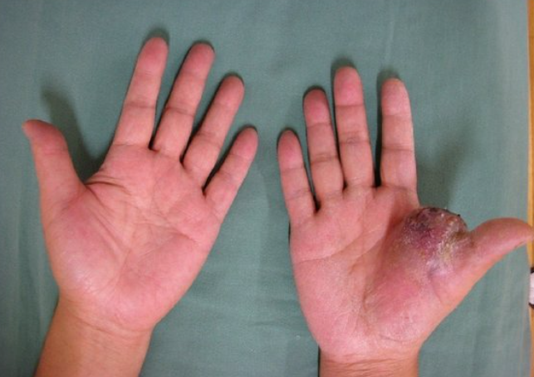
Case 2
A 65 year old man presents with a painful ulcerating lesion to his right hand.
Describe the evaluation, workup and treatment plan for a suspicious hand mass.
bssh.ac.uk

Slide 7
Case 2
A 65 year old man presents with a painful ulcerating lesion to his right hand.
This mass is extremely suspicious for a malignancy. Do you exsanguinate the hand prior to removing the mass?
bssh.ac.uk

Slide 8
Case 2
A 65 year old man presents with a painful ulcerating lesion to his right hand.
What different types of surgical margins can be used for tumours found in the hand?
bssh.ac.uk

Slide 9
Case 2
A 65 year old man presents with a painful ulcerating lesion to his right hand.
Following wide resection of the tumour, what are the options available for wound coverage?
bssh.ac.uk

Slide 10
Case 2
A 65 year old man presents with a painful ulcerating lesion to his right hand.
What are the levels of amputation in the upper limb?
bssh.ac.uk

Slide 11
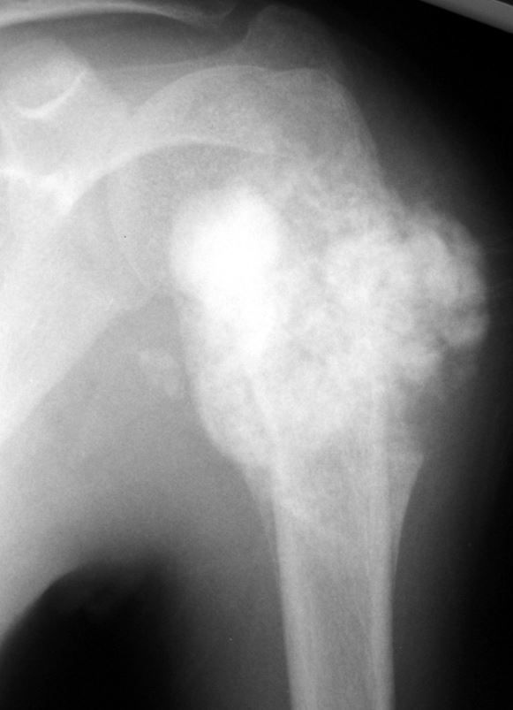
Case 3
This 22 year old man presents with pain and swelling to his upper arm.
Describe the radiograph.
What is the most likely diagnosis? Any other differentials?
bssh.ac.uk

Slide 12
Case 3
This 22 year old man presents with pain and swelling to his upper arm.
How would you achieve a diagnosis?
bssh.ac.uk

Slide 13
Case 3
This 22 year old man presents with pain and swelling to his upper arm.
The tumour is found to be an osteosarcoma with no signs of metastasis. What are the treatment options available?
bssh.ac.uk

Slide 14
Case 3
This 22 year old man presents with pain and swelling to his upper arm.
Discuss the role of the multi-disciplinary team in supporting the patient at different stages of his treatment.
bssh.ac.uk

Slide 15
Questions?

Slide 16
Teaching feedback link Module 4.8
https://s.surveyplanet.com/09bd0nvv

