Slide 1
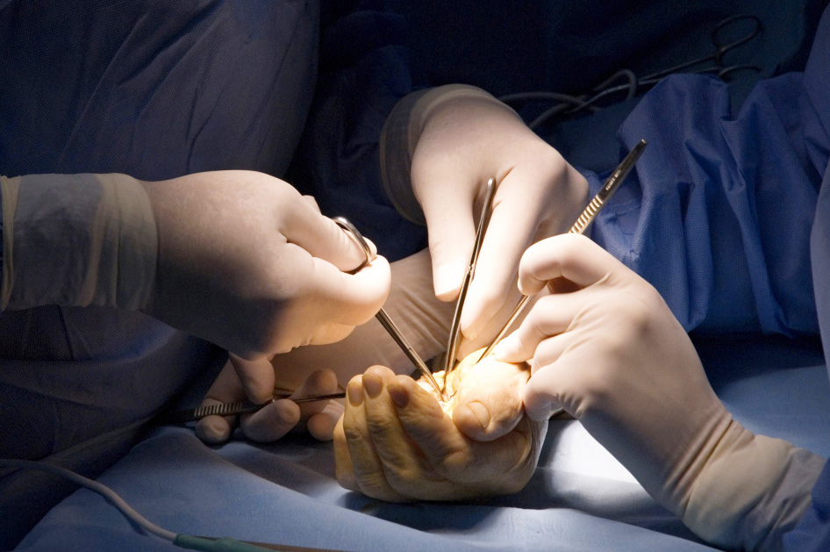
Global Hand Teaching Programme
Module 4.2
Bites: Human and animals
CBDs

Slide 2
Case 1
24-year-old student presents to the emergency department with a 36-hour history of pain, swelling, redness, and fever from a laceration to the dorsal aspect of the skin overlying the 4th metacarpophalangeal (MCP) joint of
his right, dominant hand. He says he punched a wall in a fit of rage.
Describe what you see
Do you have any doubts about the mechanism of injury, and how does this affect your management?
How would you assess the extensor tendon intra-operatively?
bssh.ac.uk

Slide 3
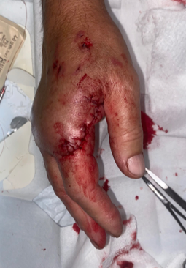
Case 2
38 year old presents acutely after breaking up a fight between two dogs. All his tendons, nerves and blood vessels appear to be functioning normally and xrays reveal no fractures.
1. How do dog bites differ from human and cat bites?
Do all dog bites require surgery
How would you choose to manage this patient?
bssh.ac.uk

Slide 4
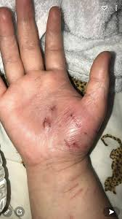
Case 3
42 year old bitten by a stray cat 4 days ago. He washed the small puncture wounds under a tap at the time and thought it would be ok. The wounds themselves have sealed over, but the thenar eminence is now extremely swollen and painful.
What has happened here?
Where do you think the infection has penetrated?
How would you manage this situation?
bssh.ac.uk

Slide 5
Questions?
For further information please ​
get in touch via the channels below:​

