Slide 1
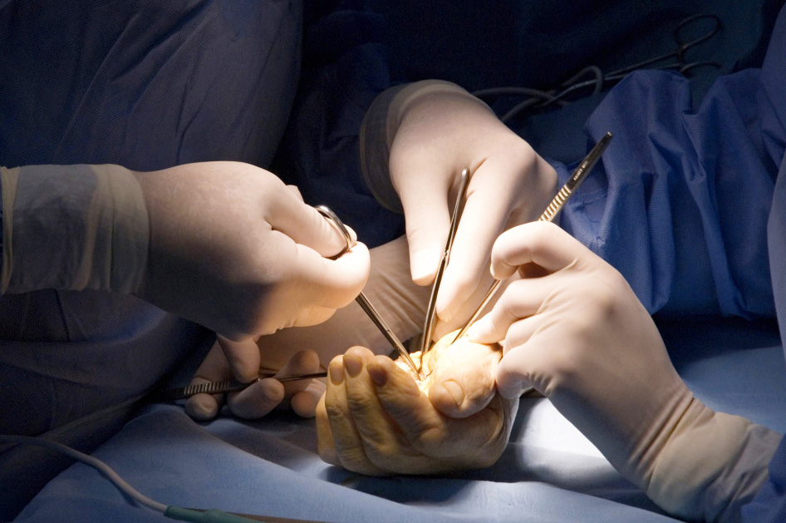
Global Hand Teaching Programme
Module 4.10
Vasospastic disorders

Slide 2
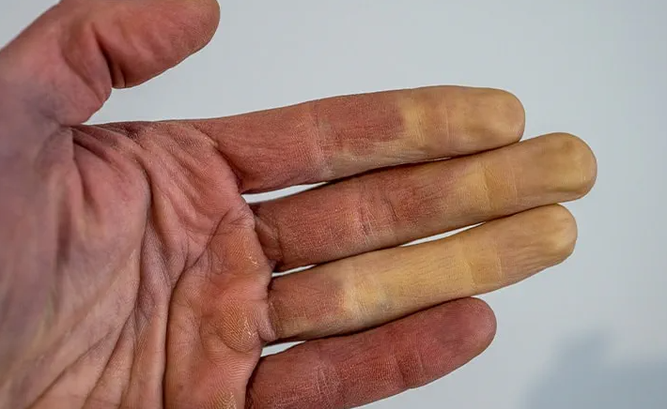
Case 1
A 50 year old woman presents to your clinic complaining of cold and painful fingertips that persist even in cold weather.
What is Raynaud’s phenomenon?
What is the different between Raynaud’s disease and Raynaud’s phenomenon?
bssh.ac.uk

Slide 3
Case 1
What is the pathophysiological process in vasospastic conditions that leads to digital ulceration or gangrene?
bssh.ac.uk

Slide 4
Case 1
What is the Wake Forest classification of occlusive / vasospastic disease?
bssh.ac.uk

Slide 5
Case 1
What are the key elements to illicit in the history?
bssh.ac.uk

Slide 6
Case 1
What are you looking for on clinical examination?
bssh.ac.uk

Slide 7
Case 1
What are you looking for on clinical examination?
bssh.ac.uk

Slide 8
Case 1
What investigations are available to help you achieve a diagnosis?
bssh.ac.uk

Slide 9
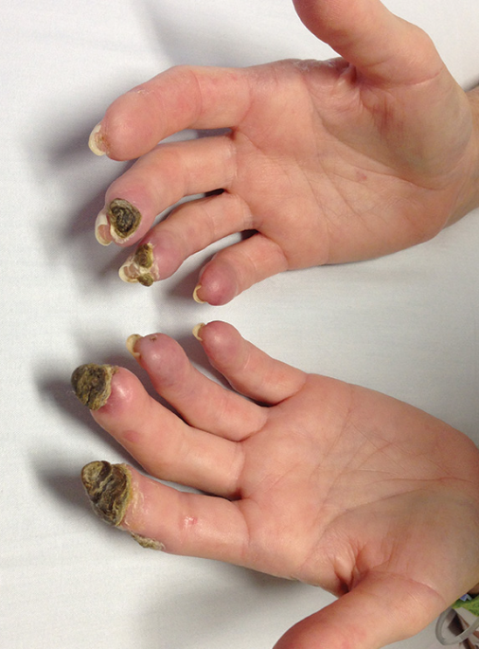
Case 2
The same patient returns to your clinic in a years time. She reports that over winter, the tips of her finger have been very painful and have developed blisters.
What pharmacological treatment options are available for patients with vasospastic disorders?
bssh.ac.uk

Slide 10
Case 2
What are the surgical options available?
bssh.ac.uk

Slide 11
Case 2
How is a sympathectomy performed?
bssh.ac.uk

Slide 12
Case 2
How can you pre-operatively evaluate response to a sympathectomy?
bssh.ac.uk

Slide 13
Case 2
How is arterial reconstruction performed?
bssh.ac.uk

Slide 14
Questions?

Slide 15
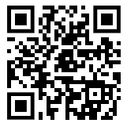
Teaching feedback link Module 4.10
https://s.surveyplanet.com/hrzatkwj

