Slide 1
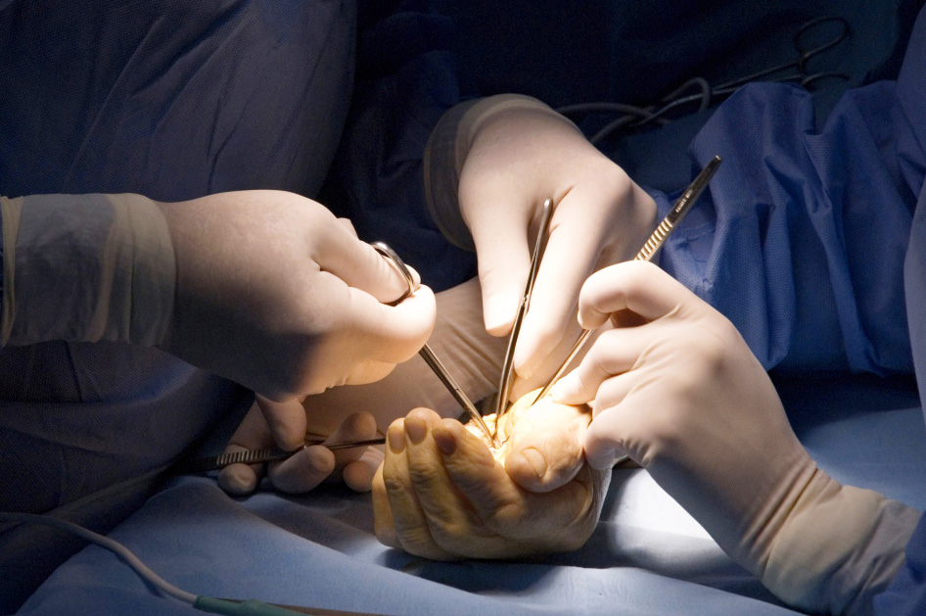
Global Hand Teaching Programme
Module 4.1
Flexor sheath and hand infections
CBDs

Slide 2
Case 1
This 16-year-old presents with a 3-day
history of progressive pain, swelling, redness, and warmth along the radial aspect of the eponychial fold of his right dominant middle finger.
His mother had expressed a small amount of pus from the area.
Describe what you see
What is the diagnosis?
What else might you look for on examination?
Management?
bssh.ac.uk

Slide 3
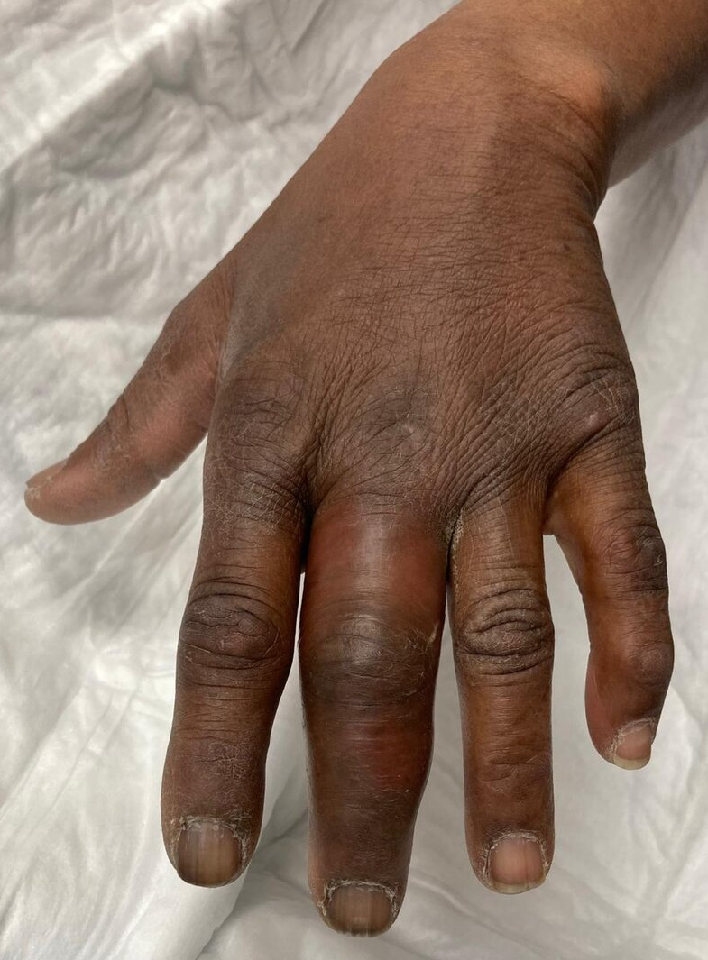
Case 2
32-year-old man is seen in the emergency department with a swollen and tender left middle
finger. He had been carrying out field work over the weekend and thinks he may have punctured
his finger.
Describe what you see
Diagnosis?
What are the key signs you look for on examination?
Management?
bssh.ac.uk

Slide 4
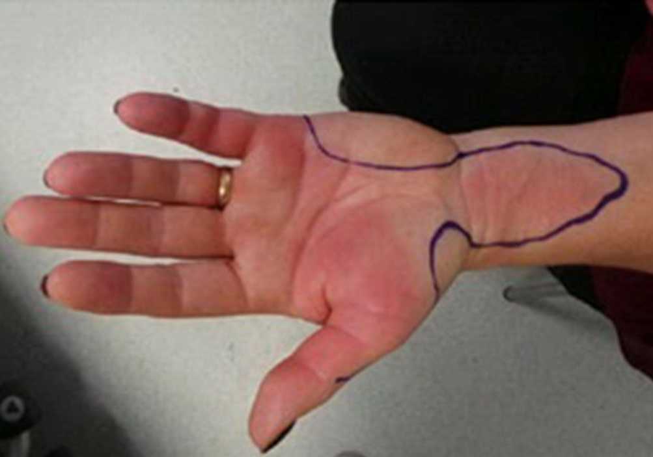
Case 3
42 year old female presents with worsening pain in and swelling in the left hand. It started after an insect bite to the left thumb, but now seems to be affecting her wrist and little finger as well. She is pyrexial and feels unwell.
What is happening here?
Describe the anatomy which has allowed this to develop
Describe the surgical approach to management
bssh.ac.uk

Slide 5
Questions?
For further information please ​
get in touch via the channels below:​

