Slide 1
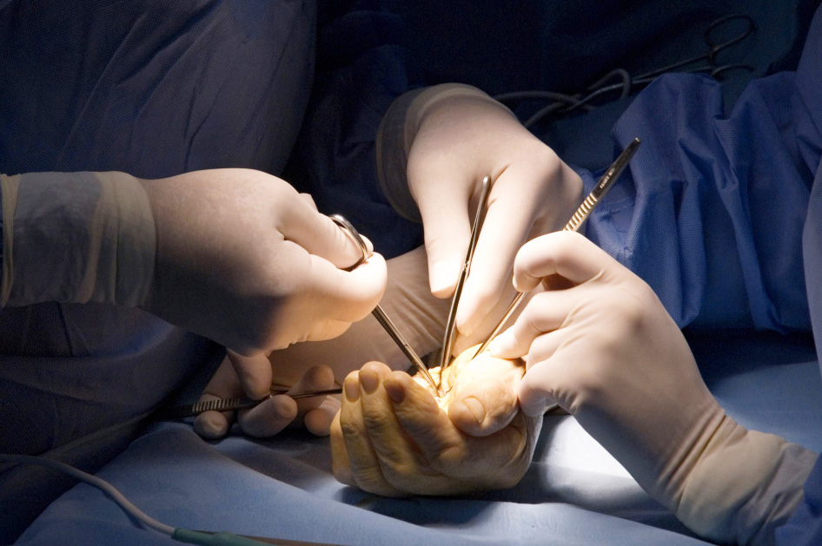
Global Hand Teaching Programme
Necrotising Fasciitis and Leprosy

Slide 2
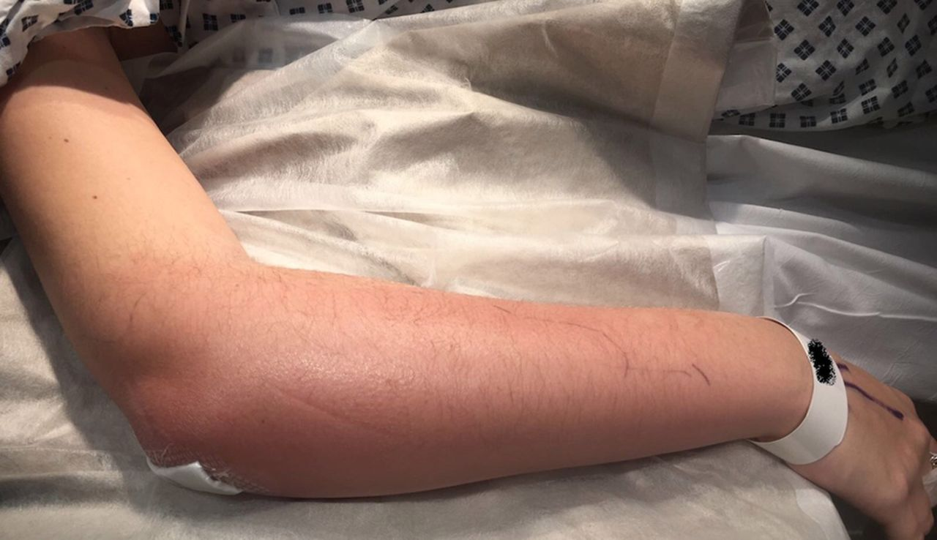
Case 1
34 year old man with obesity and type 2 diabetes presents with a painful upper limb. He is septic and pain is not controlled with morphine. He presents to A and E as shown.
What are the common organisms that cause necrotising fasciitis?
What would your initial investigations include for this patient?
Who else in the MDT would you involve In the patient’s care?
What is the surgical management going to involve ?
Nahas S, McKirdy A, Imbuldeniya A Successful management of a 24-year-old pregnant woman with necrotising fasciitis of the forearm Case Reports 2018;2018:bcr-2017-222191.
bssh.ac.uk

Slide 3
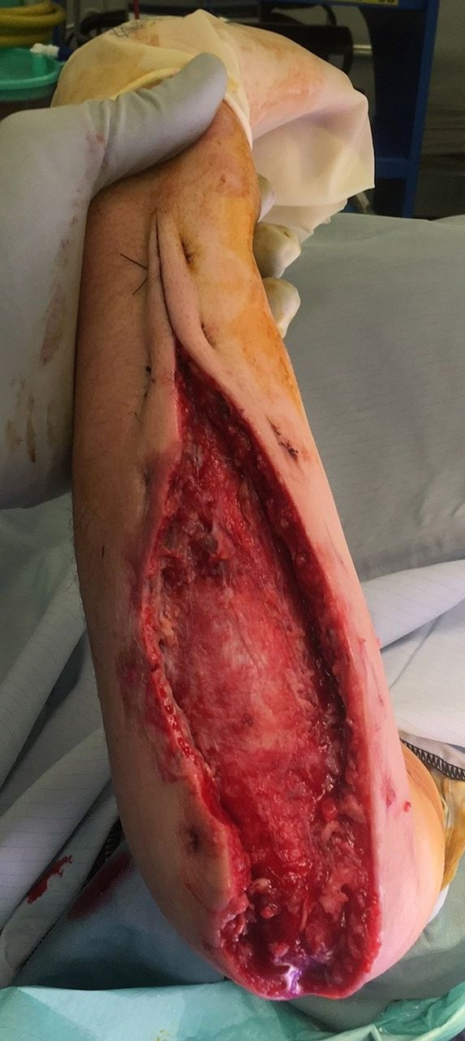
Case 2
The same case post debridement.
Do all necrotising fasciitis cases have crepitus on palpation?
Name a scoring tool used to assess likelihood of necrotising fasciitis
How would you manage the wound initially?
What are the reconstructive options?
Nahas S, McKirdy A, Imbuldeniya A Successful management of a 24-year-old pregnant woman with necrotising fasciitis of the forearm Case Reports 2018;2018:bcr-2017-222191.
bssh.ac.uk

Slide 4
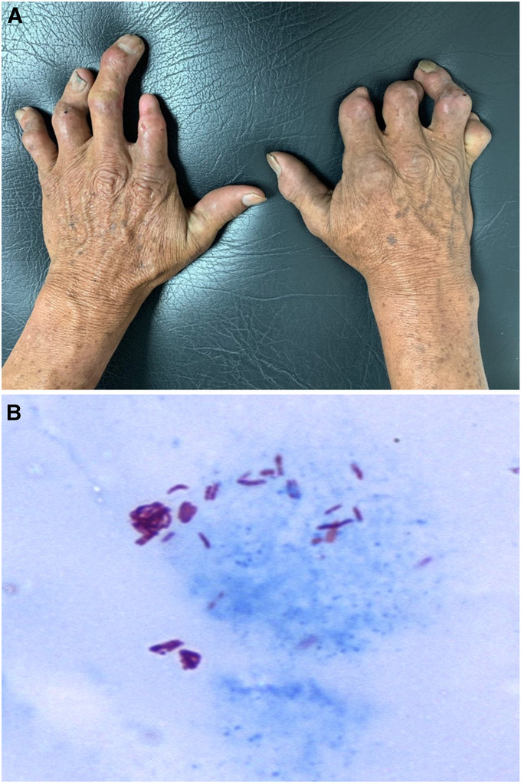
Case 3
48 year old man presents with bilateral claw hands, distal interphalangeal resorption and ulnar nerve and median nerve sensory loss. There is thenar and hypothenar wasting.
What stain is used to detect mycobacterium leprae?
How prevalent is the disease?
What are the management options?
Cataño JC, Tabares M. Claw Hand in Leprosy. The American Journal of Tropical Medicine and Hygiene. 2020;103(4):1354-1354. doi:10.4269/ajtmh.20-0701
bssh.ac.uk

Slide 5
For further information please
get in touch via the channels below:

