Slide 1
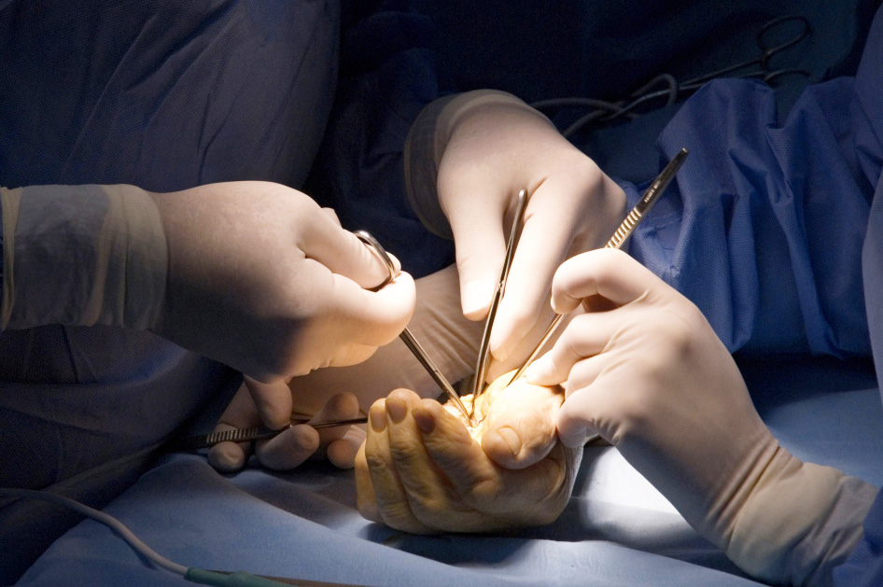
Compartment Syndrome Workshop

Slide 2
Session Objectives
To understand the surgical approach to decompression of an upper limb compartment syndrome
bssh.ac.uk

Slide 3
Faculty Information
Requirements -
A bright spacious room
Candidates arm
Cling-film as an option if candidate doesn’t want pen on the skin
Pen
bssh.ac.uk

Slide 4
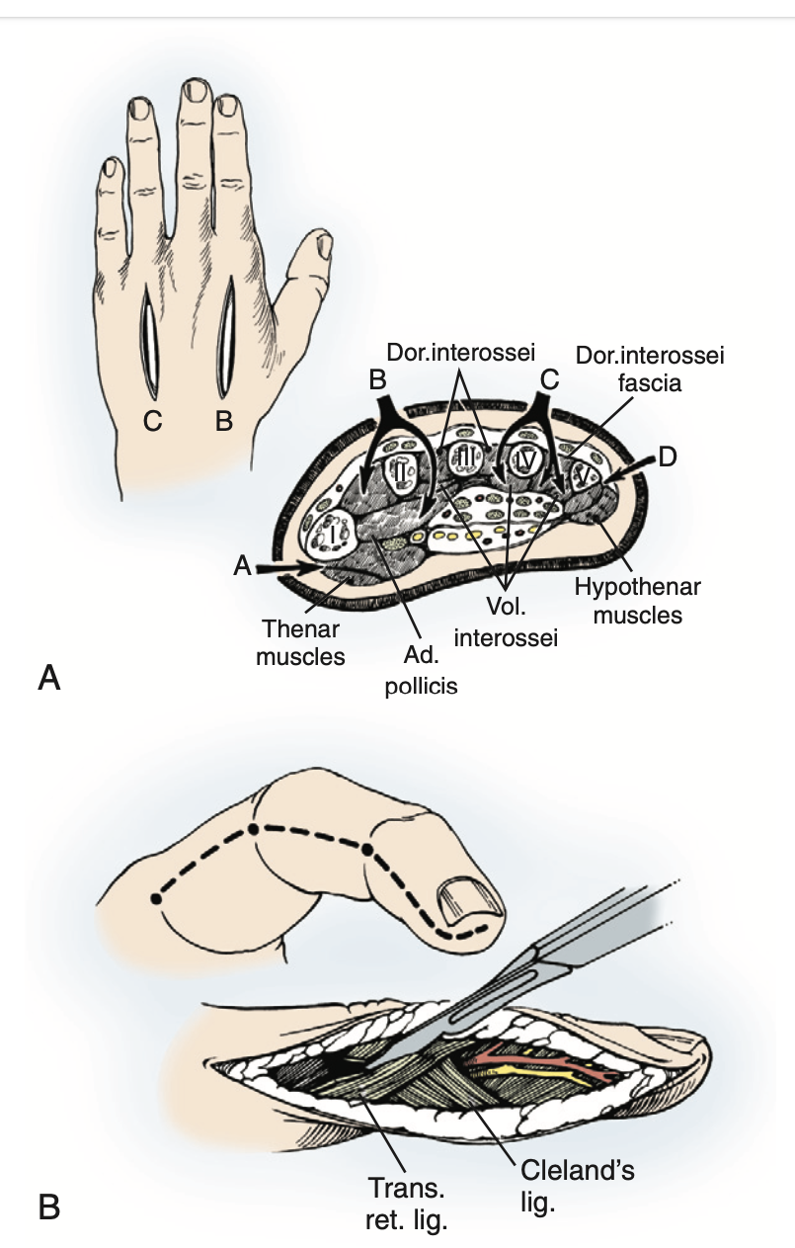
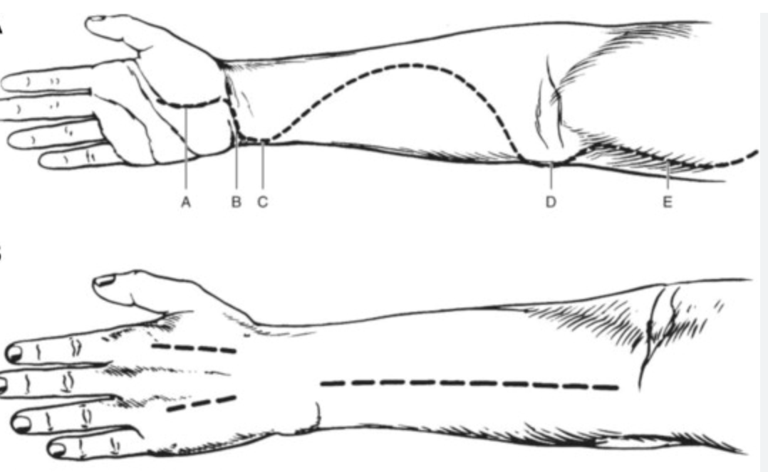
Marko Martinovski, Zachary M. Wilseck, Sarah E. Mattson,
Neonatal compartment syndrome due to compound birth presentation,
Journal of Pediatric Surgery Case Reports,
Volume 3, Issue 2,
2015,
Pages 79-81,
Green operative textbook

Slide 5
For further information please
get in touch via the channels below:

