Slide 1
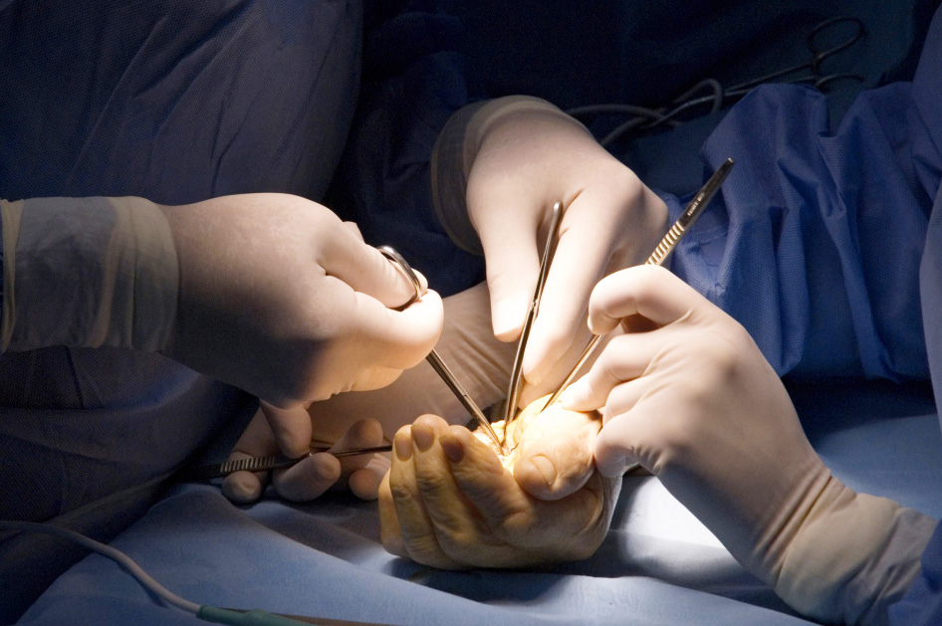
Global Hand Teaching Programme
Module 3.9
Replantation
CBDs

Slide 2
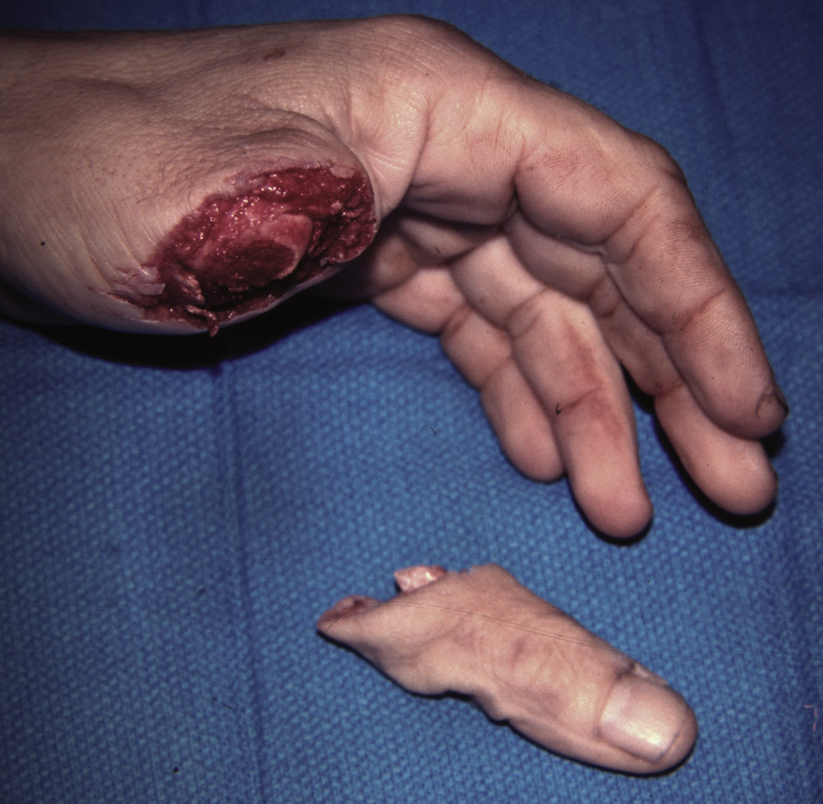
Case 1
This 42-year-old construction worker has a saw injury to his left thumb.
Describe what you see
Describe the immediate management in ED
Would you attempt replantation and why?
What structures require repair and in what order would you carry this out?
bssh.ac.uk

Slide 3
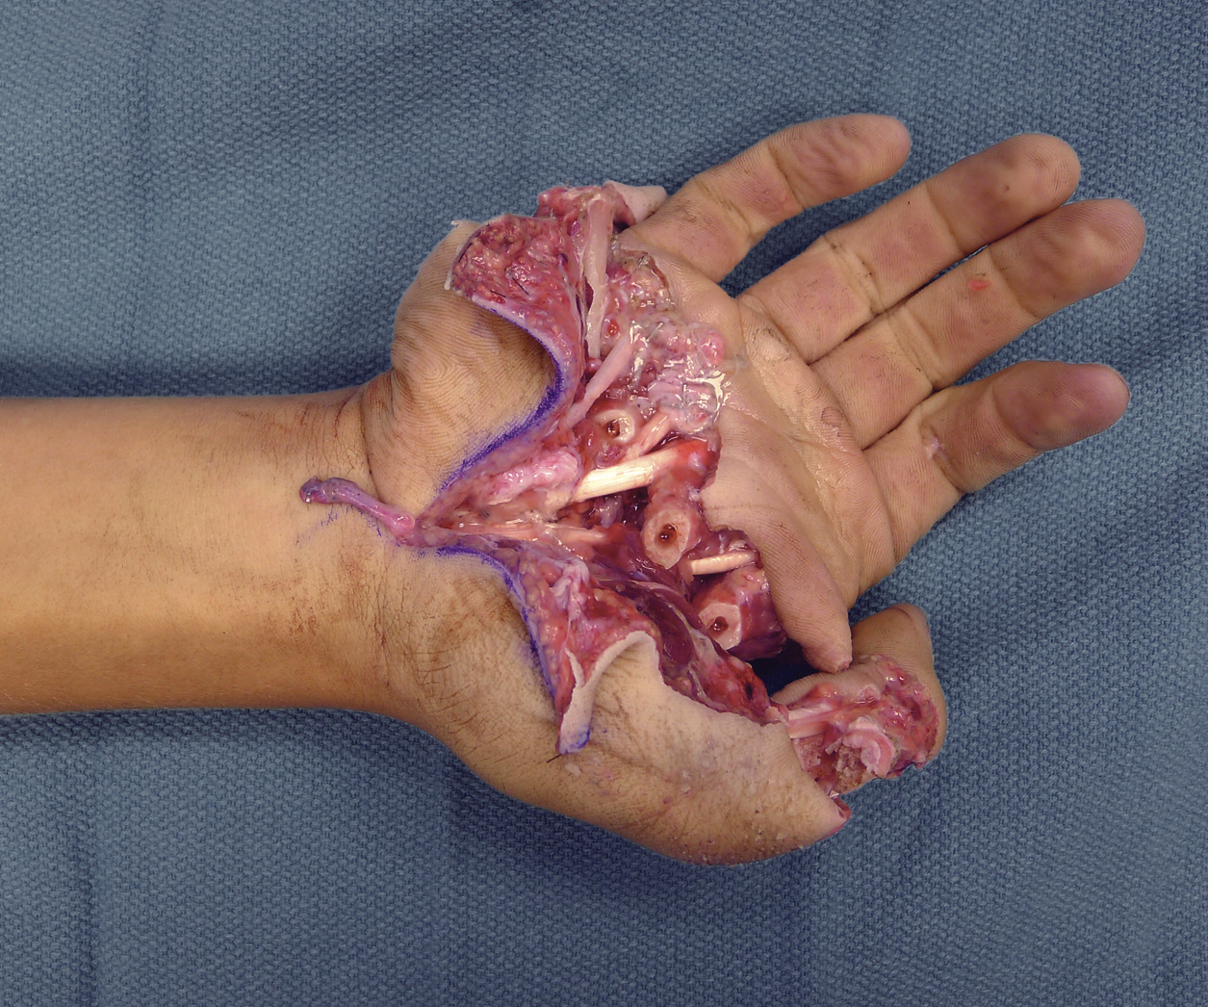
Case 2
16-year-old boy has a near-amputation of the right hand from a rollover motor vehicle
accident. The wound contained extensive dirt that has been debrided. The dorsal structures are intact.
What structures do you anticipate to be injured here?
In what order would you repair the structures and using what surgical techniques?
What sort of functional outcome is realistic to achieve?
bssh.ac.uk

Slide 4
Case 3
4-digit amputation, but only the index is deemed salvageable.
Where would you replant the digit and why?
If no fingers were salvageable, what other reconstruction options might be considered?
bssh.ac.uk

Slide 5
Questions?
For further information please ​
get in touch via the channels below:​

