Slide 1
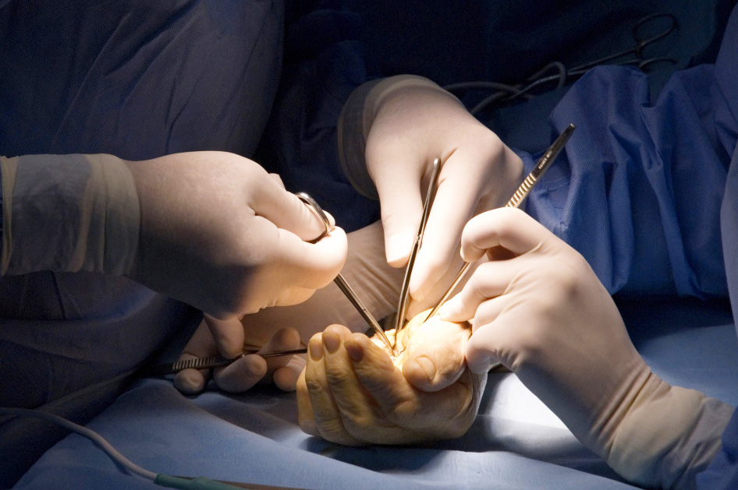
Global Hand Teaching Programme
Module 3.5
Hand flaps and forearm flaps

Slide 2
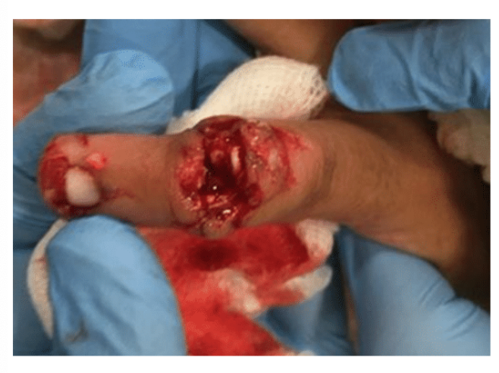
Case 1
This patient is a 22 year old woman who injured the dorsum of her left little finger while using a food blender
bssh.ac.uk

Slide 3
Case 1
Describe the injury you see?
bssh.ac.uk
Notes:
This is a clinical photograph of the left index finger showing a composite loss of tissue over the dorsum of the DIP joint of left index finger. The wound edges appear irregular. The joint is visible through the wound and there appears to be fracture. The Plain X-Ray on the right is an AP view of the finger and shows an intra-articular fracture of the head of the middle phalanx with loss bone. There is also a fracture of the tuft of the distal pahalnx.

Slide 4
Case 1
How will you manage this fracture?
bssh.ac.uk
Notes:
This is an open fracture and the patient will need a washout of the wound in the emergency room under local anaesthetic. She will also need IV antibiotics. The wound will need a formal debridement in theatre. As there is loss of bone it will not be possible to reconstruct the joint. It is advisable to remove the loose bony fragment and stabilise the joint with a K-wire. It is also a consideration to formally fuse the joint by removing the cartilage from the base of the distal phalanx and bringing the bone ends together. In that case one needs to use two K-wires to prevent rotation of the bone

Slide 5
Case 1
How will you manage this wound?
bssh.ac.uk
Notes:
The wound edges will need debridement. This will leave a soft tissue defect which can be reduced if the bone ends are shortened. If a primary closure if not possible one needs to consider a flap

Slide 6
Case 1
What soft tissue flaps can be used to close this wound?
bssh.ac.uk
Notes:
One option is to use a hatchet flap from the dorsum of the proximal phalanx. This is a rotation flap with a V-Y advancement at the base. The other option is to use a reversed cross finger flap. Here the skin over the dorsum of the middle phalanx area of the ring finger is lifted and the adipofascial flap turned over. The wound will need a skin graft over the little finger and the skin which was lifted off the ring finger is put back

Slide 7
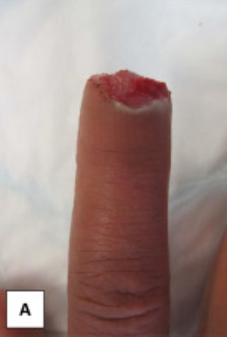
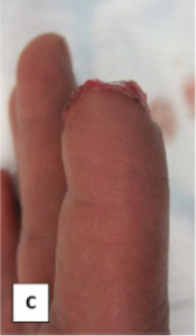
Case 2
A 32 year old professional pianist presents with an injury to her index finger sustained using the food processor.
Describe the defect that you see.
bssh.ac.uk

Slide 8
Case 2
What are the key goals of flaps in the hand?
What local flap options are available? Describe how you would design them and the pitfalls associated with them.
bssh.ac.uk
Notes:
Preserve length, preserve sensation, preserve movement, expedite rehabilitation
- VY advancement flap, homodigital island flap, cross finger flap, thenar flap

Slide 9
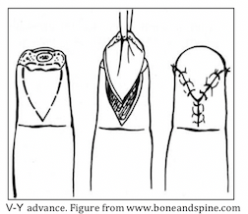
Case 2
Who described this flap?
What kind of injuries is this flap appropriate for?
What is the maximum advancement for this kind of flaps?
bssh.ac.uk
Notes:
Though frequently termed the Atasoy flap, Tranquilli-Leali first described the volar V-Y flap in 1935
The volar V-Y flap is a triangular-shaped volar advancement flap outlined with its tip at the distal interphalangeal crease
The local flap is most applicable for transverse and dorsal avulsions when a relative abundance of pulp skin is present
Then the V is scored through the dermis and care must be taken to avoid injuring the traversing vessels into the triangular-shaped flap

Slide 10
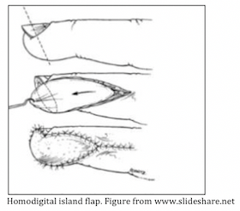
Case 2
bssh.ac.uk
Notes:
Each lateral flap is raised as an island on its own neurovascular bundle and has a much bigger volume and reconstructive potential.
Originally, segmuller raised the flaps only as far proximally as the DIPJ crease. Lanzetta et al described the use of a modification in which the flap is extended back to the PIPJ.

Slide 11
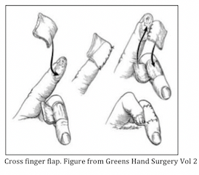
Case 2
bssh.ac.uk
Notes:
Originally described by Gurdin and Pangman in 1950. The cross finger flap is commonly used for volar tip injuries with exposed obne or tendon when insufficient pulp for the volar V-Y flap is present
Requires two operations and a skin graft
The fingers become stiff during the delay between the two stages
The flap is elevated from the adjacent finger dorsum in the plane above the peritenon to allow for grafting of the donor site
A full thickness graft can be taken to close the donor finger dorsum
The flap is opened like a book cover, turned 180 degrees, and inset into the fingertip defect. The fingers may be sutured together or even pinned to prevent flap dehiscence
During the delay, gentle active range of motion exercises may be required to prevent joint stiffness of both fingers
At 2-3 weeks the flap is divided an dinset and more aggressive active and passive range of motion exercises are begun

Slide 12
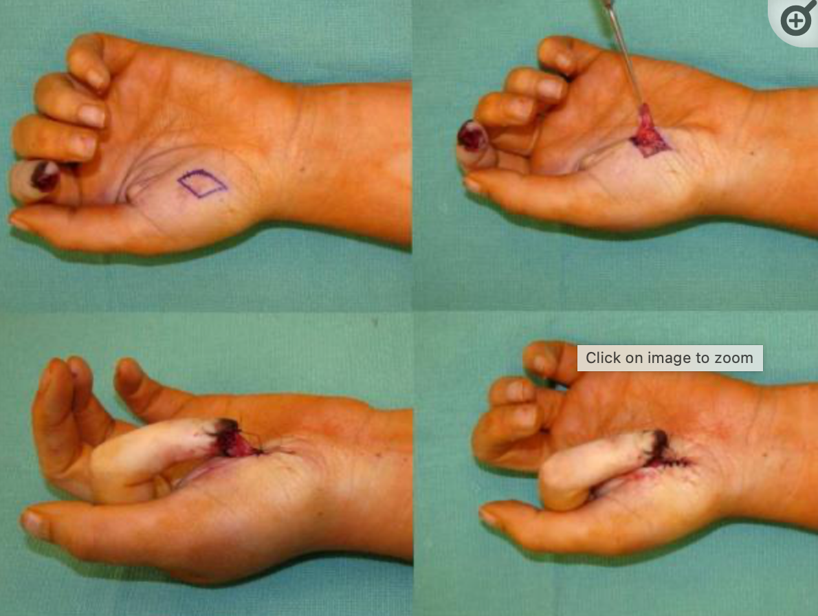
Case 2
Thenar flap (hand clin)
bssh.ac.uk
Notes:
The thenar flap is a random pattern flap and does not need any specific vascular dissection. The skin over the thenar eminence is supplied by the superficial palmar branch of the radial artery.
After thorough debridement of the injured fingertip, the digit is flexed so that the defect leaves an imprint on the thenar eminence. The distal end of a proximally based flap is inset into the nail bed, whereas the distal end of a distally based flap is inset into the pulp
Care must be taken to avoid injuring the radial digital nerve of the thumb. Avoid raising a flap close to first web to prevent web space contractures. The secondary defect is closed linearly.
Flap inset is done over the proximal and lateral aspects of the finger defect and dressings applied. It is important to ensure that the flap does not get kinked while in the dressings. Flap division is performed 2-3 weeks later.

Slide 13
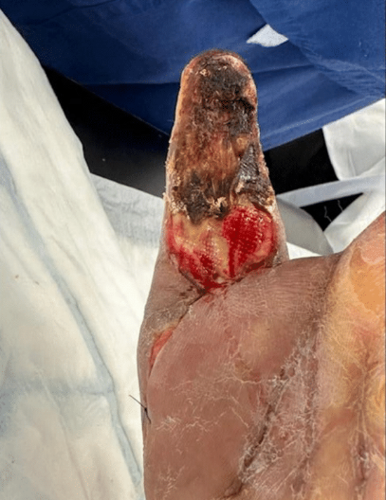
Case 3
A 70 year old diabetic man presents with a necrotic wound on the right thumb following a pulp infection.
What are the key points in clinical examination?
bssh.ac.uk
Notes:
One needs to look at the size and extent of the wound. It looks like the entire pulp is involved. One should check for any active or passivemovements in the thumb. One should examine the dorsum of the hand and forearm for possible flap donor sites

Slide 14
Case 3
What investigations would you like to do?
Foucher flap (springer link)
bssh.ac.uk
Notes:
One needs to do basic blood examinations such as haemoglobin, full blood count, Blood sugar and renal function test and other investigationsto evaluate anaesthetic fitness. One also needs to do a wound swab and an X-Ray of the thumb

Slide 15
Case 3
What are the options for reconstruction?
bssh.ac.uk
Notes:
This wound will need a debridement and if the underlying bone is healthy, a reconstruction can be considered. The options will be a Foucherflap from the dorsum of the index finger, a forearm flap such as reversed radial forearm flap or a grin flap. If the patient is otherwise fit andyounger a toe pulp free flap is also an option. If the bone is osteomyelitic, one may need to do an amputation of the thumb

Slide 16
Case 3
Given his age and comorbidities what will your choice for reconstruction be?
Brunelli flap (from Plastic Surgery Key)
bssh.ac.uk
Notes:
My preference would be to do a Foucher flap reconstruction.

Slide 17
Case 4
A 32 year old woman presented with this chronic wound to the dorsum of her middle finger following a burn injury 2 months ago. On examination there is exposed extensor tendon, but the wound bed is healthy.
What reconstructive options are available to her?
bssh.ac.uk
Notes:
Dorsal metacarpal artery flap

Slide 18
Case 4
Dorsal metacarpal artery flap (Hand Clin)
bssh.ac.uk
Notes:
Quaba Flaps
Reverse fasciocutaneous island flap based on a branch from the dorsal metacarpal artery – useful for reconstruction of skin defects in the distal hand and over the proximal digits
First described by Quaba and Davison in 1990 – noted that multiple longitudinal dorsal hand incisions for RA patients did not result in ischemic skin islands
Vascular Pedicle / Arterial Anatomy
- Based on recurrent cutaneous branch from the dorsal metacarpal artery or perforators from the dorsal communicating branch from the common digital artery (Quaba perforator)
- Pedicle diameter is 0.3 to 0.5 mm
- Pedicle is locaed 0.5 – 1cm proximal to the MCP joint, but distal to the junctura tendinae
Applications & Limitations
- Useful for dorsal hand defects in the distal third to distal half of the hand (long, narrow flap)
- Also useful for web space reconstruction and dorsal digital reconstruction to the level of the PIP joint (occasionally level of middle phalanx)
- Not useful for palmar coverage or coverage of the proximal half of the hand
- Limited reach to digits beyond the adjacent metacarpal
Technique
- Design an ellipse that can extend from the MCP joint to the dorsal wrist crease
Flap width can vary from 1 – 3.5 cm, often is amenable to primary closure
Do not dissect the pedicle directly
Begin incision on one side of the ellipse down to paratenon, then dissect from proximal to distal- Can take fascia overlying the interossei if desired, or take a slip of extensor tendon (including one of the small branches from the dorsal metacarpal artery) to enable a vascularized tendon reconstruction
Pearls / Pitfalls
• Pencil doppler is useful in identifying the perforator around the MCP joint
• The vessel is very small, be careful not to skeletonize it during the dissection
• Elevate proximal to distal, leave paratenon intact in case primary closure is not possible
• Small crossing perforators from the dorsal metacarpal artery to the tendons can be
ligated if not harvesting a composite flap

Slide 19
Case 5
A 27 year old carpenter presents with an injury to his non-dominant thumb sustained whilst using the circular saw. There is loss of majority of the pulp and exposed bone.
What reconstructive options are available to him?
bssh.ac.uk
Notes:
Foucher flap, Moberg flap

Slide 20
Case 5
bssh.ac.uk
Notes:
Moberg Flap Key Points
Sensate flap to cover volar thumb soft tissue defects
Use for thumb defect only – fingers do not have consistently predictable dorsal blood supply
Can resurface abut 2.0 cm volar defect or most of distal phalanx
Elevate flap off flexor sheath to MP flexion crease
Both radial and ulnar neurovascular bundles are included in the flap
If additional length is needed, use V‐Y advancement or make transverse cutaneous only incision to allow advancement with skin graft as needed.
The IP joint can be flexed if needed to gain additional length. Some people will pin the IP joint in flexion, but I have not found this necessary.

Slide 21
Case 6
A 16 year old girl presented with a wound to the dorsum of her left hand following a road traffic accident 4 days ago.
The wound has been debrided and is now ready for reconstruction.
What options would be suitable for reconstruction in this case?
bssh.ac.uk
Notes:
Radial forearm flap, PIA flap, Becker flap

Slide 22
Case 6
Reverse radial forearm flap (Plastic Surgery Key)
bssh.ac.uk
Notes:
RADIAL FOREARM FLAP
FLAP: Free flap or Pedicled, antegrade or retrograde pedicle TISSUE: Fasciocutaneous, fascial, or osteo-fasciocutaneous DIMENSION: Maximum 8 x 20cm
ARTERY: Radial artery (3-4 mm)
VEINS: Two vena comitantes (1-2 mm) and cephalic system (3-5 mm) NERVE: Lateral antebrachial cutaneous nerve
SURGICAL TECHNIQUE:
Confirm complete arch with Allen test (preoperatively). (Confirm complete arch again intra-operatively before definitively dividing radial artery by placing a temporary hemo-occlusion clip.)
Mark flap centered over the course of the vessel.
Subfascial dissection cuff toward the vessels. - SAFER
Suprafascial dissection - MORE ADVANCED
IMPORTANT POINTS:
Keep fascial septum contiguous with vessels
Good coverage for areas that require flat, thin, and supple flaps
Dissect distal to proximal - for both antegrade and retrograde pedicles
Can use as flow-through free flap
Pre prepared for distal veno-venous anastomosis or anastomosing cephalic vein if any signs
of venous congestion present.
DISADVANTAGES:
Conspicuous donor site with potential tendon scarring/adhesions
Sacrifice of major forearm artery

Slide 23
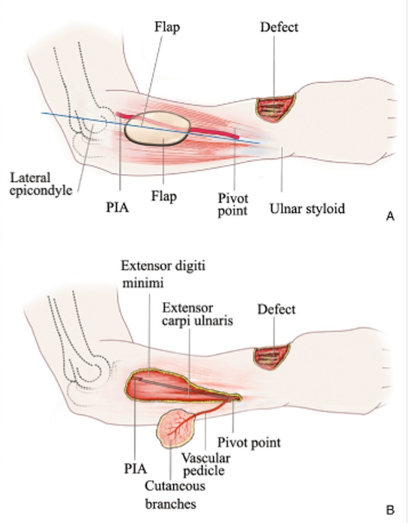
Case 6
Posterior interosseous artery flap
bssh.ac.uk
Notes:
The posterior interosseous artery flap is based on the posterior interosseous artery as it courses in the extensor compartment of the forearm. The artery arises as a branch of the common interosseous division of the ulnar artery. In 10% of cases, it may arise directly from the ulnar artery. It passes posteromedially between the chorda obliqua and the superior edge of the interosseous membrane and enters the posterior compartment of the forearm between the heads of the supinator and abductor pollicus longus. It then divides into an ascending and descending or main trunk on which the flap is based. The surface marking of the artery is a line joining the lateral epicondyle of the humerus to the ulnar styloid in the fully pronated hand. The artery emerges into the posterior compartment at the junction of the upper and middle thirds of this line and the flap may be designed therefore along the distal two thirds of this line. The usual design of the flap is a distally based type, relying on retrograde flow through the dorsal carpal arch and the anastomosis of the anterior and posterior interosseous arteries at the wrist.
The flap is marked along the artery usually in the mid forearm. The dissection is commenced by incising distally to expose the vessel along its axis. The distal artery may be extremely thin and fragile and no attempt should be made to skeletonise it.
The septum between the extensor carpi ulnaris and extensor digiti minimi is identified and parallel incisions made in the deep fascia on either side to include the septum and the fragile vessels within it, which lie in close opposition to the undersurface of the deep fascia in the distal third of the forearm. The dissection should not be carried distally beyond a point 2 cm proximal to the ulnar styloid where the artery anastomoses with the anterior interosseous branch and is the distal pivot point of the flap.
­
The artery may then be traced proximally and the incisions deepened around the previously marked flap which is raised to include the deep fascia and the intermuscular septum with the artery which lies deeply between the muscles in the mid forearm. Care must be taken to preserve the posterior interosseous nerve and especially the motor branch to the extensor carpi ulnaris which crosses the artery at its superior limit.
The design of this flap also permits the inclusion of bone and a segment of the proximal ulna with a cuff of the extensor pollicus longus muscle with the muscular branches of the artery may be raised, as an osteocutaneous flap.
The main uses of this flap are in hand surgery for resurfacing soft tissue defects and in thumb reconstruction. Extended variations of the flap to include large areas of the forearm skin and the skin of the distal third of the arm have been recently described. The donor defect may be closed primarily or skin grafted.

Slide 24
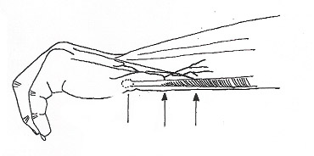
Case 6
Becker flap
bssh.ac.uk
Notes:
The vascular basis of this flap is a constant branch which arises from the ulnar artery on its ulnar aspect, 2 to 4 cms proximal to the pisiform bone. The vessel ranges in length from 3 to 7 cms and 1 to 1.5mm in diameter. It courses deep to the tendon of the flexor carpi ulnaris and divides into several branches which supply adjacent structures and the skin. The cutaneous branch pierces the deep fascia and divides into ascending and descending branches. The ascending branch runs in the long axis of the forearm along the ulnar border for up to 15 to 20 cms. The descending branch supplies the skin on the dorsal aspect of the hand and a small branch to the abductor digiti minimi.
The venous drainage of this flap is provided by the venae comitantes which accompany the artery and the subcutaneous veins in the vicinity. The flap does not possess a specific sensory nerve supply and hence cannot be designed as a sensate flap.
The flap is designed on the ulnar border of the distal forearm with a slight bias towards the dorsal surface. The pivot point of the flap is approximately 2cms proximal to the pisiform bone on the arterial trunk.
A flap which may be up to 20 cms in length, and 9 cms in width is designed and the dissection commenced on the dorsal aspect. The flap is dissected and may, if desired, be raised without the deep fascia because of the mainly subcutaneous ramification of the cutaneous branches. The dissection is performed with care as the pedicle is approached 2 cms proximal to the pisiform bone, and may be visualized as it pierces the deep fascia. It is possible to dissect the flap without identifying the vascular pedicle if it is designed for use as a local transposition flap without being islanded. The flap may be rotated through 180 degrees on its vascular pedicle, in a clockwise or anticlockwise direction, if the descending branch is divided at the distal limit of the flap to permit rotation.

Slide 25
Case 7
A 18 year old man presented with a ring avulsion injury to his ring finger, sustained when he fell off a fence. He presented at 12 hours post injury as he was intoxicated at the time.
He is very keen to not proceed with an amputation but wants to preserve as much finger length as possible.
What reconstructive option can you offer him?
bssh.ac.uk

Slide 26
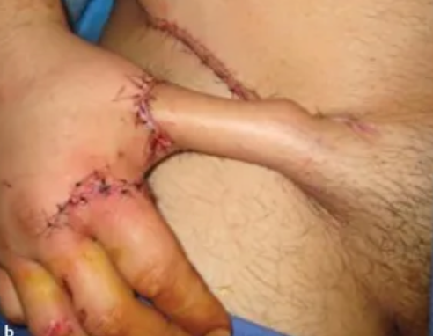
Case 7
Groin flap
bssh.ac.uk
Notes:
The groin flap is an axial pattern flap based on the superficia1 circumflex iliac artery. It can be used as a pedicle flap particularly in hand reconstruction or as a free flap because of its excellent donor site. The flap is based on the superficial circumflex artery which has a variable origin usually from the femoral artery. Venous drainage is by a superficial and deep system of veins with the superficial system being the more dominant. This comprises the superficial circumflex iliac vein either as a single vessel or as a group of veins which drain into the superficial epigastric vein and subsequently into the venae comitantes which accompany the artery and drain into the femoral vein. The origin of the superficial circumflex artery can be marked on the skin surface 2.5 cm below the mid point of the inguinal ligament. When used as a pedicled flap, the flap is usually raised from the lateral to medial and at the lateral border of the sartorius, the fascia is included so as to preserve the vascular pedicle.
When raised as a free flap, the technique is totally different. Here it is best to commence with a medial perpendicular incision over the femoral artery to identify the origin of the superficial circumflex iliac artery and determine its size and suitability for microvascular surgery. At the same time, superficial veins passing medially are isolated and preserved. With the vascular pedicle secured medially, then the marginal incisions can be completed and at the medial border of the sartorius, the vascular pedicle is identified and preserved intact. When used as a pedicle flap, usually this extent of dissection at the medial border of the sartorius is not performed and is not advisable. The groin flap still has a use in reconstructive hand surgery and also in free tissue transfer. Its popularity in the latter area however, has diminished because of the unreliable and relatively small vascular pedicle. It remains popular however, because of the excellent donor site which can be closed directly.

Slide 27
Questions?

Slide 28
Teaching feedback link M3.5
https://s.surveyplanet.com/wq6f6361

