Slide 1
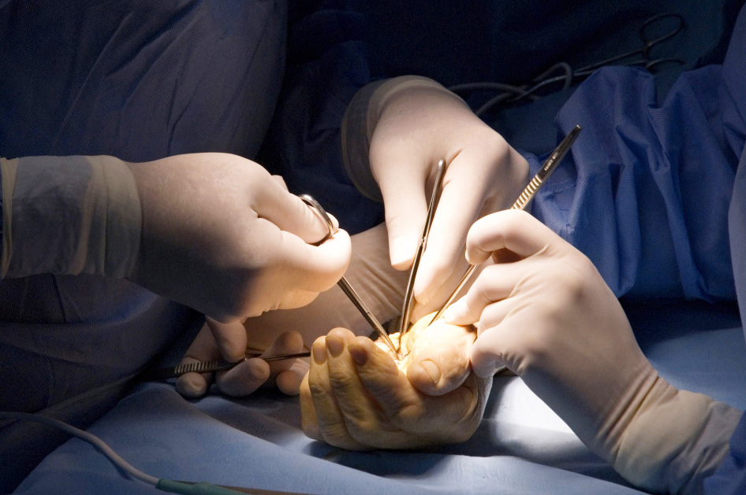
Global Hand Teaching Programme
Module 3.10
Amputation, transplantation & prostheses
CBDs

Slide 2
Case 1
35yr old polytrauma following a car accident. Crush injury to the right forearm and hand associated with devascularisation, bone and skin loss, plus a right open femur fracture and splenic injury requiring emergent laparotomy.
Is limb salvage an option here? What features may make primary amputation more favourable?
At what level would you amputate? Would you consider elbow disarticulation and why?
bssh.ac.uk

Slide 3
Case 2
Is this an active or passive prosthesis?
At what amputation level might you use it?
Name the labelled components
A
B
C
D
bssh.ac.uk

Slide 4
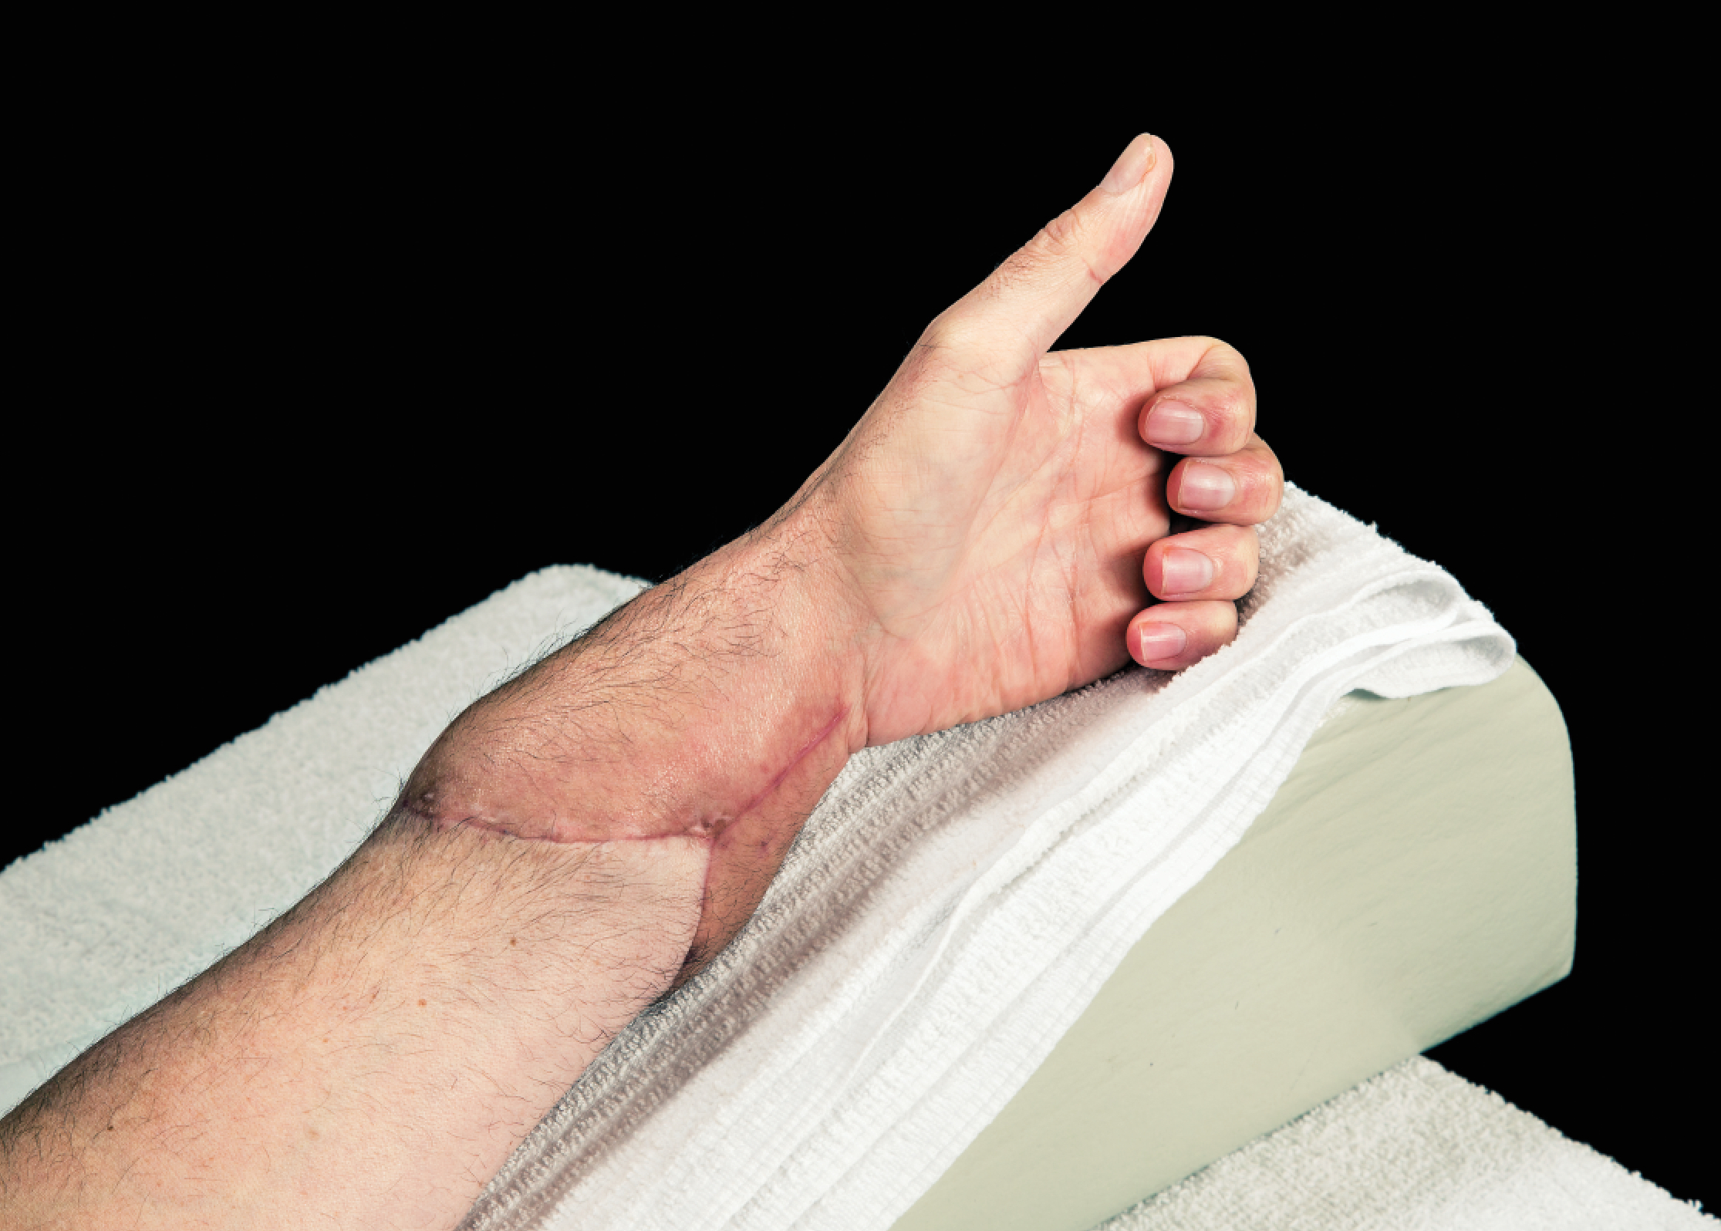
Case 1
What are the ideal characteristics of a hand transplant recipient?
What level of amputation tend to do best with a transplantation?
What are some of the potential complications associated with transplantation?
bssh.ac.uk

Slide 5
Questions?
For further information please ​
get in touch via the channels below:​

