Slide 1
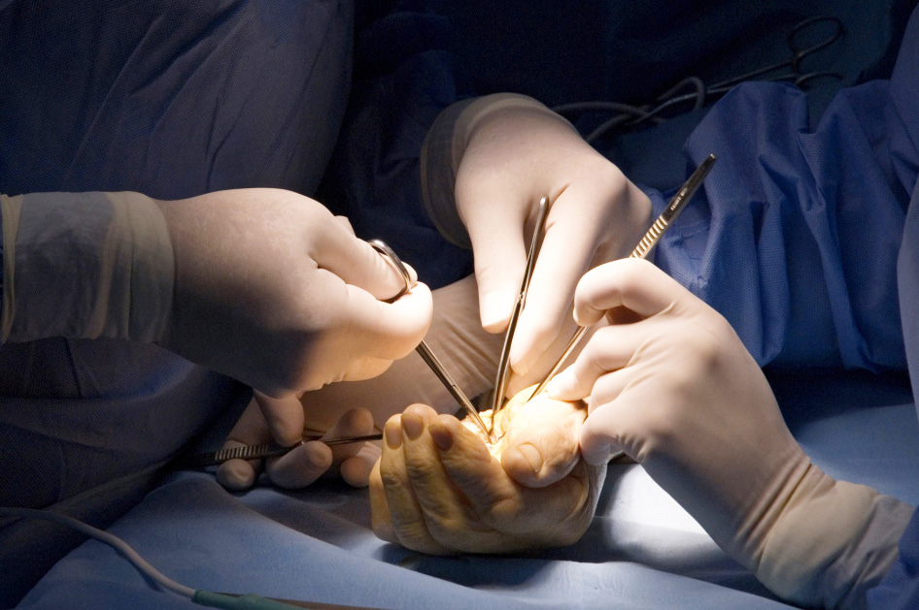
Global Hand Teaching Programme
Module 2.4
Extensor tendon repair and reconstruction
CBDs
Source: Wide Awake Hand Surgery (Donald Lalonde)

Slide 2
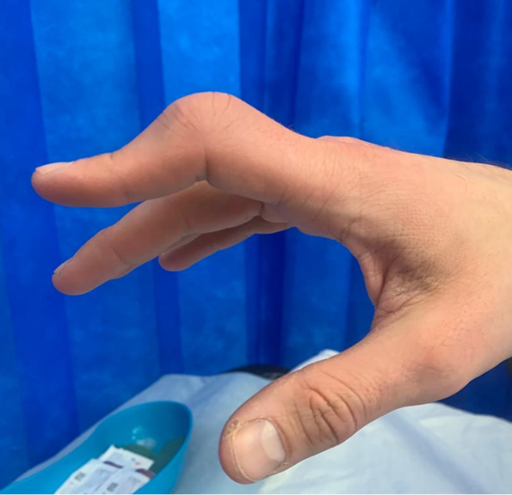
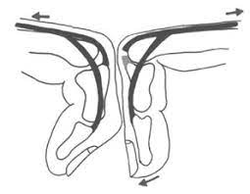
Case 1
A 28 year old male chef presents to the emergency department with a laceration overlying the PIP joint of his left index finger.
Describe what you see
Which structures might be involved?
What special test can be performed to assess for a boutonniere injury? Describe how this test works.
Discuss the management of this injury in the acute and chronic setting.
If you don’t treat this condition what is the likely long term results?
How will you rehabilitate the patient after repair?
bssh.ac.uk
Notes:
Answers
Describe the injury you see? 2. What structures might be involved
It is a clinical photograph of the right index finger showing a Boutonniere deformity. This is due to an injury to the central slip of the extensor tendon which was not repaired. The patient is unable to extent the PIP joint and the DIP joint is in hyperextension.
3.
Acute boutonniere deformity
Modified Elson test: DIPJ extension is limited in PIPJ flexion due to tethering of the lateral bands at the trifurcation of the extensor tendon. If the central slip is injured, the tethering is lost, allowing active DIPJ extension despite PIPJ flexion.
4. I will take a detailed history and perform a clinical examination. I would like to check if the finger can be passively fully straightened. I would like to check if the wound has healed and that there are no other injuries. I will also get an X-Ray of the finger to make sure that there are no bony or joint injuries.
I will discuss the treatment plan with the patient. It will need an exploration and repair of the central slip. This can be done under local anaesthetic. If the central slip is injured very close to the insertion, I am also need to use a K-wire across the joint to keep it in extension.
5. If you don’t treat this condition what is the likely long term results?
If you don’t treat it, the deformity is likely to get worse and the joint will get stiffer. Later on it may not be possible to passively straighten the finger as the joint will develop a contracture.
6. How will you rehabilitate the patient after repair?
After the operation I will apply a POP back slab volar aspect of the finger to keep the PIP joint straight. If I have used a K-wire across the PIP joint, I would keep it for four weeks. I will convert the POP back slab into a thermoplastic splint to keep the joint in extension. I will leave the DIP joint free and ask the patient to actively mobilise it. I will keep the splint for 6 weeks in total.
Images:
https://www.orthobullets.com/hand/6012/boutonniere-deformity
https://journals.sagepub.com/doi/abs/10.1177/175899830601100402?journalCode=htha

Slide 3
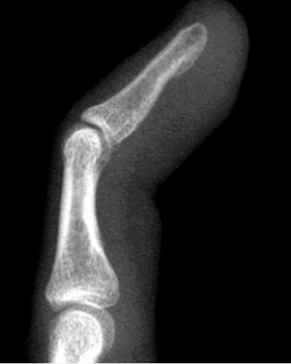
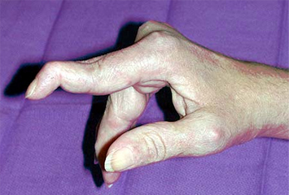
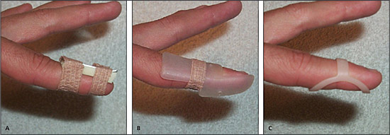
Case 2
Discuss the typical presentation and examination of a patient with a mallet finger.
Discuss the indications for surgery in patients with mallet finger.
Describe the non-operative and operative management of a patient with mallet finger.
What are the important considerations in the rehabilitation of a patient with mallet finger?
bssh.ac.uk
Notes:
Mallet injury
Flexed DIPJ and reduced active extension of DIPJ
Indications for surgery: open, crush injuries, significantly displaced or incongruent bony mallet injuries
Options: extension splint; Ishiguro extension block wiring; primary repair of tendon-only injuries, tenodermodesis (closing skin and tendon en masse); transarticular wiring
Rehab important points: patient compliance, regular review, maintain movement of the PIPJ, pragmatic approach.

Slide 4
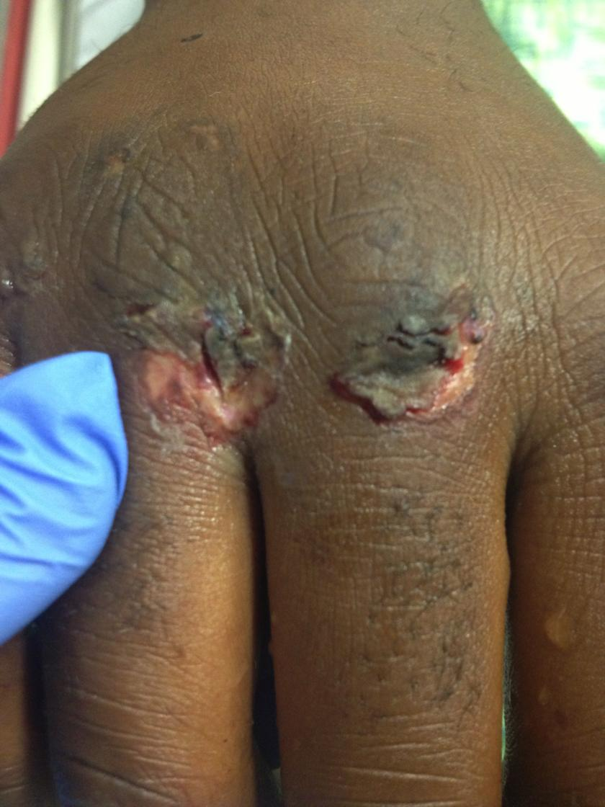
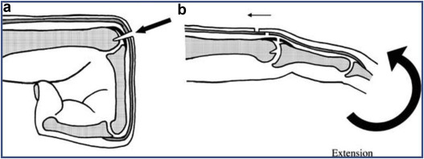
Case 3
What are the important considerations in the assessment of a patient with a ‘fight-bite’ injury?
Which structures may be involved?
What are the important management considerations?
What are the commonly encountered organisms in human bite injuries?
bssh.ac.uk
Notes:
Fight bite injury
Considerations of assessment: reluctance in history, tendon retraction (injured in full flexion), clean vs. unclean, possible joint involvement.
Structures: skin, extensor tendon, sagittal band, joint capsule, articular surface
Management considerations: manage as septic arthritis, systematic evaluation of all structures under GA with arm tourniquet, joint not to be breached if not traumatically breached, swabs to guide antimicrobial therapy, relook washouts.
Further surgeries might involve suture removal, or arthrodesis or amputation of damaged PIPJ.
Organisms: classically ‘Eikenella corrodens’, but Staph and Strep species more common.
Images:
https://www.orthobullets.com/hand/6104/human-bite
https://www.sciencedirect.com/science/article/abs/pii/S1555415518307803

Slide 5
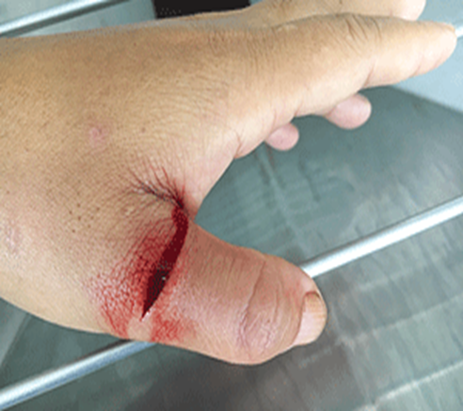
Case 4
A 25 year old man presents after sustaining a cut on the dorsum of his left thumb with a knife.
He is unable to straighten the thumb.
Which tendon is likely to be injured?
How will you repair it?
How will you rehabilitate the patient?
If this patient presented a few months after the injury what will be the treatment options?
bssh.ac.uk
Notes:
Answers
Which tendon is likely to be injured?
The extensor pollicis longus tendon is likley to be injured in zone 2 or zone 3.
2. How will you repair it?
It will need a repair which can be done under local or regional anaesthetic. Under tournqiuet the wound should be explored and if the tendon is found divided, the woubd may need extension to expose the tendon ends. One should check if the MCP joint is open and if it is it will need a thorough wasbhout. The tendons is usually flat as this level and a standard core suture may be diffiocult. If that is the case, a mattress suture reinforced with epitendinous sutures or a locking continous suture or a SIlfverskiold suture alone can be used. I will use a 4-0 Ethinond or PDS suture as Prolene or Nylon can have an extrusion problen in a subcutaneous location.
3. How will you rehabilitate the patient?
I will apply a POP backslab to keep the thumb extended and after the first wound check apply a splint to keep the thumb IP joint extended for 5 weeks in total.
4. If this patient presented a few months after the injury what will be the treatnent options?
If the patient presents late the tendon ends may have a gap and a primary repair will not be possible. If that is the case, the options are either to do a tendon graft or a tendon transfer. My preference would be to do a EIP to EPL transfer as it will make it a simpler option.

Slide 6
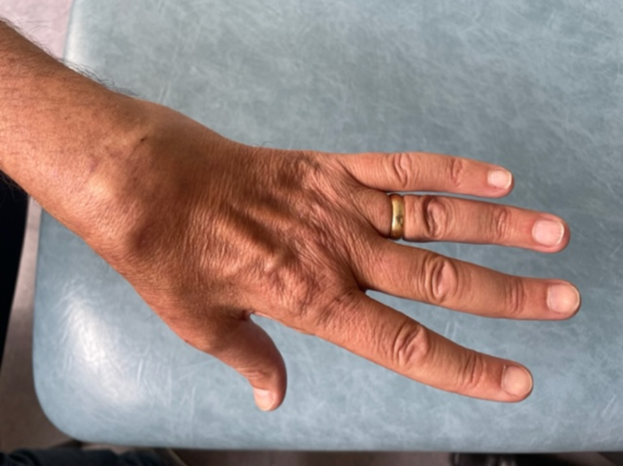
Case 5
A 51 year old man sustained a fracture of the distal radius which was treated in a plaster for 6 weeks.
After removing the plaster his thumb appears dropped. He cannot actively extend it.
What is the reason for this condition?
How will you manage this condition?
How will you rehabilitate the patient after repair?
Which other condition can you get a similar pathology?
bssh.ac.uk
Notes:
Answers:
1. What is the reason for this condition?
He appears to have developed a rupture of the EPL tendon. This is a known complication of distal radius fracture. It is more common in minimally displaced fractures and the pathology is thought to be loss of blood supply to the tendon which comes from the periosteum, increase in volume of the extensor compartment and a subsequent ischaemic rupture.
2. How will you manage this condition?
The best surgical option is to do an EIP to EPL transfer. EIP tendon is found on the ulnar side of the extensor hood of the index finger. The tendon is divided and routed subcutaneously to the anatomical snuff box area and an end to end or end to side weave to EPL performed.
3. How will you rehabilitate the patient after repair?
After the operation the thumb is immobilised in a POP back slab keeping the wrist and thumb in extension. After the first dressing change it can be changed to a thermoplastic splint keeping the wrist and thumb extended for a total of 5 weeks.
4. Which other condition can you get a similar pathology
One can get a closed rupture of EPL in Rheumatoid arthritis.

Slide 7
For further information please
get in touch via the channels below:

