Slide 1
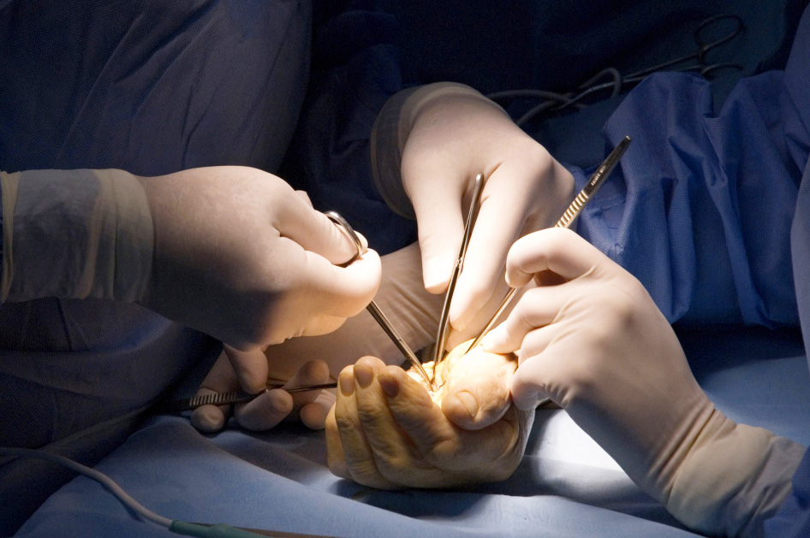
Global Hand Teaching Programme
Cases for Wound Healing and Complications

Slide 2
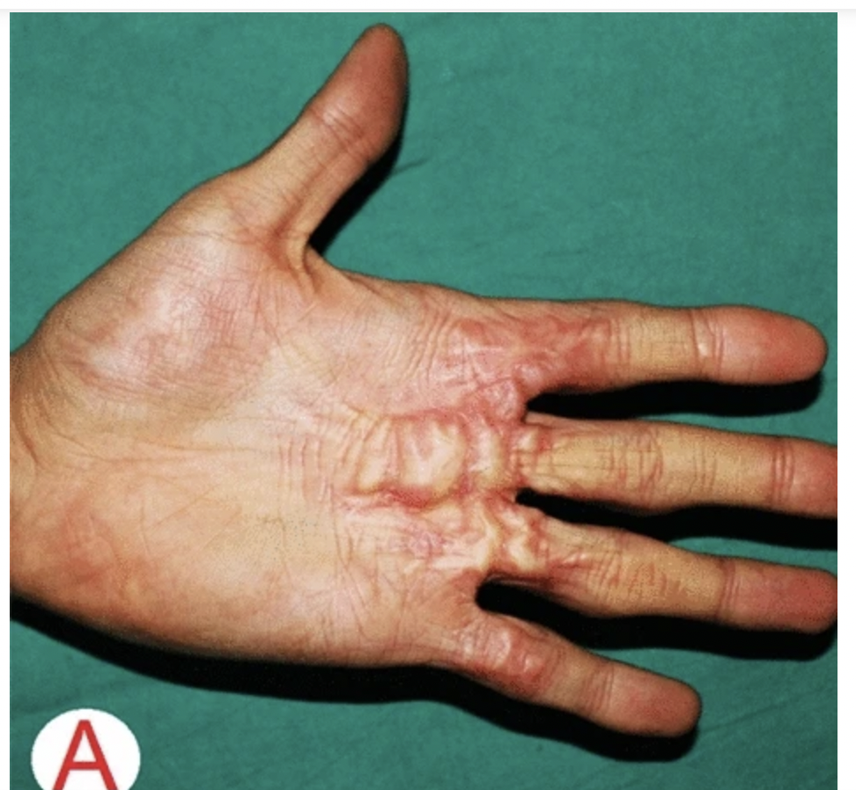
Case 1
18 year old man with this wound to his left hand following an injury left to heal by secondary intention 2 years ago.
What is the difference between keloid and hypertrophic scars?
What are your management options for this patient?
Li, K., Nicoli, F., Cui, C. et al. Treatment of hypertrophic scars and keloids using an intralesional 1470 nm bare-fibre diode laser: a novel efficient minimally-invasive technique.
bssh.ac.uk

Slide 3
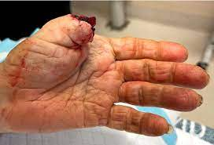
Case 2
68 year old man with amputation of left thumb
What factors are important to establish in this patient’s history to give you an idea of wound healing potential and success of a replant?
http://www.boneschool.com/upper-limb/hand/replants
bssh.ac.uk

Slide 4
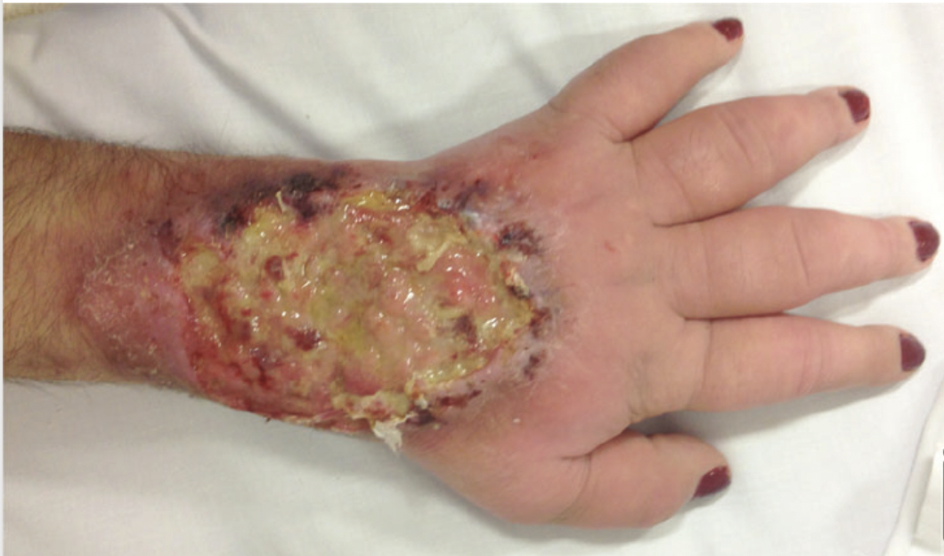
Case 3
54 year old woman with type 1 diabetes, 20 year history of smoking and obesity has a non healing chronic wound.
Describe the phases of wound healing
How does smoking and diabetes affect wound healing on a pathological basis?
What other factors from the image could be contributing to poor healing?
York B et al. Diagnosis: Chronic Osteomyelitis
Eplasty. 2014
bssh.ac.uk

Slide 5
For further information please
get in touch via the channels below:

